Slide 1
An Experimental Investigation of SIMO, MIMO,Interference-alignment (IA) and Coordinated Multi-Point (CoMP)”
Per Zetterberg and Nima N. Moghadam
INTERNATIONAL CONFERENCE ON SYSTEMS,
SIGNALS AND IMAGE PROCESSING (IWSSIP)

Slide 2
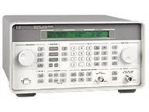
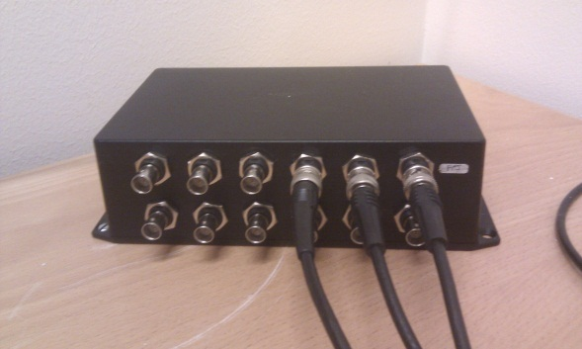
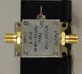
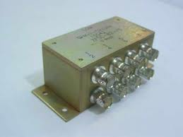
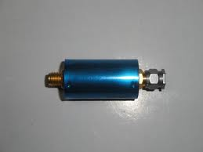
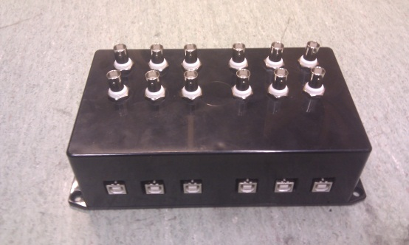
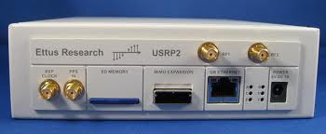
The USRP-based testbed: synchronization
10MHz ref.
GPS receiver
Output: 1PPS
NMEA (RS232)
On 50Ω cable
USB splitter
Output: 1PPS (50Ω)
NMEA: USB
To PC

Slide 3
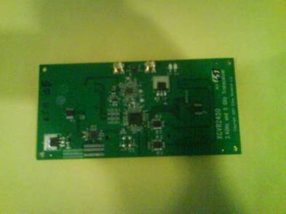

RF-hardware: TX
XCVR2450
USRP2 / N210
Mini-circuits ZHL 1724HLN
2.49GHz

Slide 4
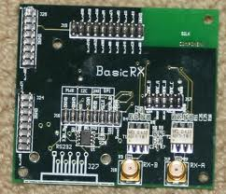
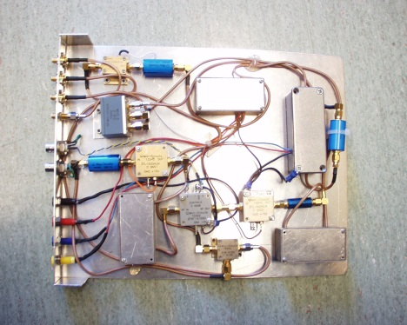
RF-hardware: RX
USRP2 / N210
70MHz
Amplifier
Mixer

Slide 5
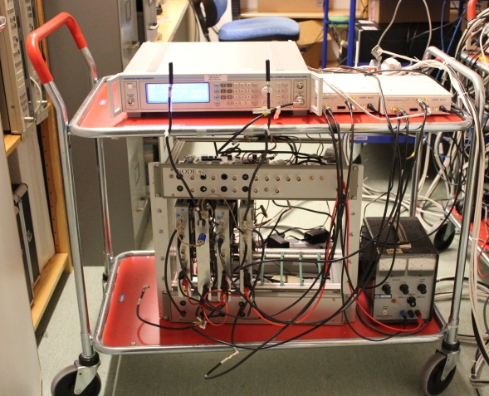
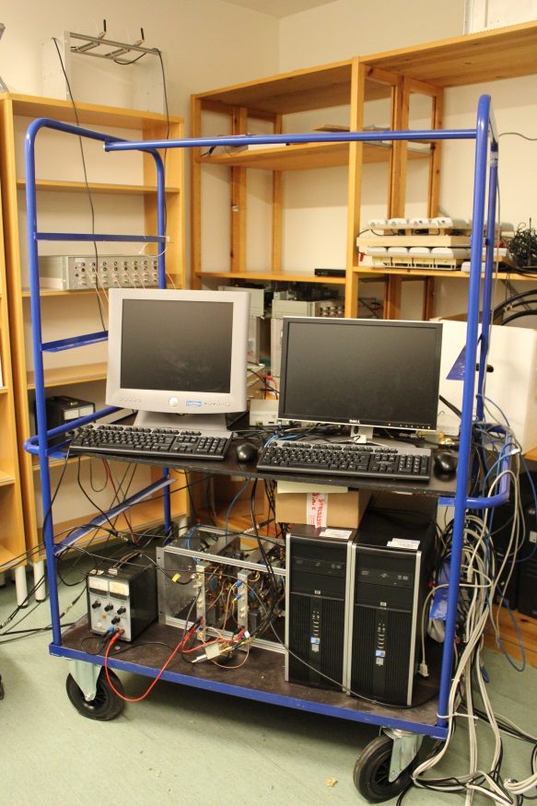
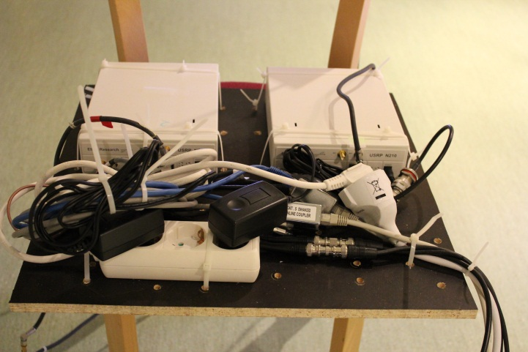
The testbed
3MS
10m
3BS
P=15dBm
NF=10-11dB
10m

Slide 6
The 4Multi Software FrameWork
(Multi-Antenna, Multi-User, Multi-Cell, Multi-Band)
Send data in small bursts (relaxes computational load)
Nodes synchronized by external trigering (PPS)
The implementor (basically) only need to program three functions
node::init, node::process and node::end_of_run.
Simulate the system using “simulate” generic function.
Everything that can be compiled with gcc can run (e.g IT++)
Toolbox with coding&modulation.
Store _all_ received signals for post-processing.
Vision:
“The coding should be as easy as performing ordinary
(but detailed) desktop simulations”

Slide 7
Software
IA_node
IT++
OFDM1
AMC
calculate_
beamformers
four_multi
UHD driver
boost
kernel
ethernet
PPS
USRP
10MHz

Slide 8






Implementation IA
Feedback:
Wired ethernet
MS 1
$$u_{1}$$
BS 1
$$v_{1}$$
$$u_{2}$$
BS 2
MS 2
$$v_{2}$$
$$u_{3}$$
$$v_{3}$$
BS 3
MS 3

Slide 9



Implementation: CoMP
Feedback:
Wired ethernet
MS 1
$$u_{1}$$
BS 1
$$v_{1}$$
$$u_{2}$$
BS 2
MS 2
$$v_{2}$$
$$u_{3}$$
$$v_{3}$$
BS 3
MS 3

Slide 10
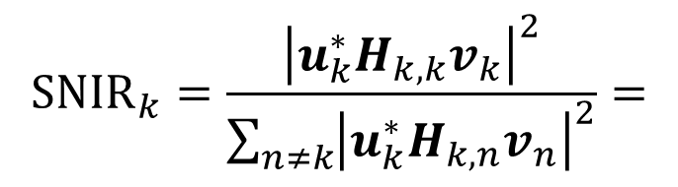
Beamformer
$${\text{SNIR}}_{k}=\frac{{\left|u_{k}^{∗}H_{k,k}v_{k}\right|}^{2}}{\sum_{n≠k}{{\left|u_{k}^{∗}H_{k,n}v_{n}\right|}^{2}}}=$$
Formulate virtual uplink SINR. Iterate
“Approaching the Capacity of Wireless Networks through Distributed Interference Alignment", by Krishna Gomadam, Viveck R. Cadambe and Syed A. Jafar.

Slide 11
Frames
Demodulation reference signals
CSI reference
signals
Payload
10 OFDM symbols
Payload
10 OFDM symbols
MS feed-back CSI to BS1.
BS1 calculate beam-formers.
BS1 sends weights to BS2, BS3.
BS1-BS3 frequency locked.
38 subcarriers,
312.5kHz carrier-spacing
QPSK, …., 256QAM
0.25, 0.5, 0.75 –rate LDPC codes

Slide 12
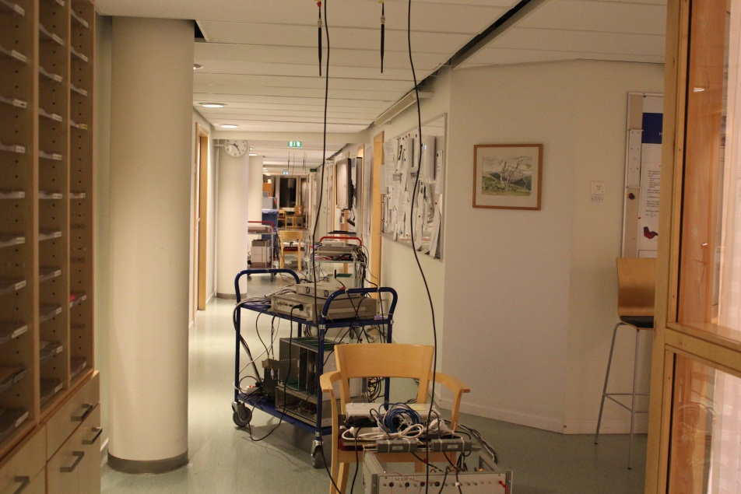
Measurement Campaign
3BS + 3MS
Measurement divided into 116 batches.
Each batch 5 frames for IA, CoMP, MIMO, SIMO
MS moved several wavelengths between each batch.

Slide 13
Results
16QAM, 0.75 rate coded.
.
 | All-data |  | Best BS
Method | FER | C-FER | FER | C-FER | Rate | C-rate
IA | 0.31 | 0.04 | 0.21 | 0.02 | 2.36 | 2.95
CoMP | 0.01 | 0.00 | 0.01 | 0.00 | 2.98 | 2.99
TDMA-MIMO | 0.08 | 0.01 | 0.04 | 0.00 | 1.93 | 2.00
TDMA-SIMO | 0.00 | 0.00 | 0.00 | 0.00 | 1.00 | 1.00
All-MIMO | 0.99 | 0.92 | 0.98 | 0.87 | 0.13 | 0.78
All-SIMO | 0.76 | 0.55 | 0.61 | 0.31 | 1.18 | 2.07

Slide 14
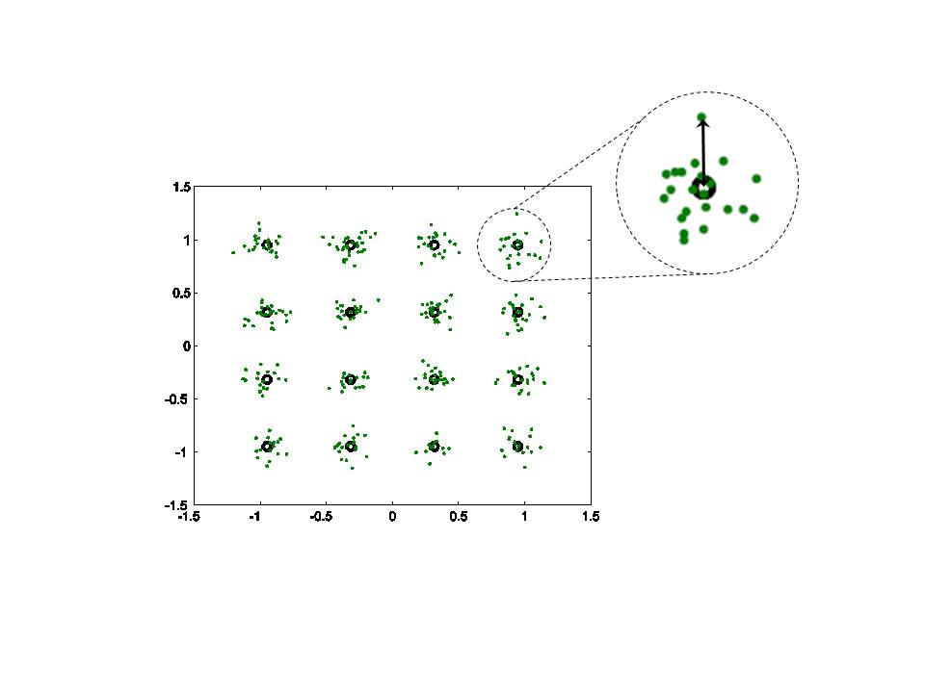
How far from ideal ?

Slide 15
SINRD per sub-carrier: IA

Slide 16
SINRD per sub-carrier: CoMP

Slide 17

Average over subcarriers

Slide 18
Ideal versus actual
IA
Ideal
Actual
CoMP
Actual
Ideal

Slide 19
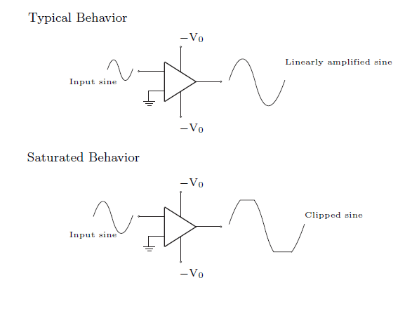

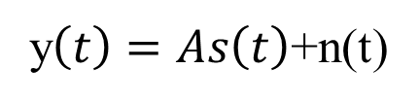
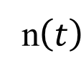
Power-Amplifier Non-linearity
OFDM signals:
n$\left(t\right)$
$$s\left(t\right)$$
+
y$\left(t\right)=As\left(t\right)$+n(t)
Modeled as noise:
D Dardari, V. Tralli, A Vaccari “A theoretical characterization of nonlinear distortion effects in OFDM systems“, IEEE Trans. Comm., Oct 2000.

Slide 20
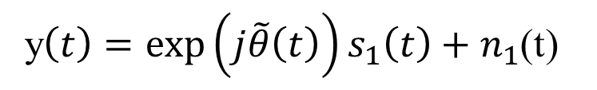
Phase-noise
Modeled as additive noise + CPE
BPF
LNA
LPF
A/D
CPE: Slowly varying between symbols
y$\left(t\right)={\text{exp}\left(j\tilde{θ}\left(t\right)\right)s}_{1}\left(t\right)+n_{1}$(t)
R. Corvaja, E. Costa, and S. Pupolin, “M-QAM-OFDM system performance in the presence of a nonlinear amplifier and phase noise, IEEE Trans. Comm. 2002.

Slide 21








RF-impairment model
$${n\left(t\right)}_{tx,1}$$
$${n\left(t\right)}_{rx,1}$$
$$φ_{1}$$
+
+
CPE $σ$=0.6deg
$$H\left(t,f\right)$$
$${n\left(t\right)}_{rx,6}$$
$${n\left(t\right)}_{tx,6}$$
$$φ_{6}$$
+
+
34dB below signal
40dB below signal

Slide 22
Closing the gap: IA
Ideal
Model
Actual

Slide 23
Closing the gap: CoMP
Ideal
Model
Actual

Slide 24
Closing the gap TDMA-SIMO
Ideal
Model
Actual

Slide 25
Closing the gap TDMA-MIMO
Ideal
Model
Actual

Slide 26
Actual SINRD versus
Path-loss ratio
SINRD
IA
Path-loss ratio
SINRD
CoMP
Path-loss ratio

Slide 27
Conclusion
CoMP and IA implemented on a wireless test-bed.
Both IA and CoMP perform better than reference schemes SIMO and MIMO.
CoMP provides best performance.
Small hardware impairments degrade performance significantly in particular CoMP.
Impairment model proposed - fair agrement with measurements => test on more complex scenarios.
Hardware characterization can be improved.

Slide 28
Next step
Implement adaptive modulation and coding.
More streams in CoMP.
Model hardware with detailed AM/AM, AM/PM and phase-noise spectrums.

Slide 29
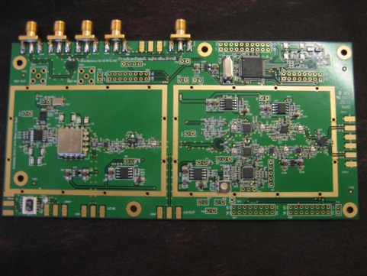
Radios
XCVR2450
Dual-band TRX 2.4GHz,5GHz
Tx power: 4 dBm (nice and linear)
RX NF: 20dB
Home-brewed receiver:
0.2-3GHz. NF: 10dB.
Ramin Fardi – design.
5GHz TRX. Goal: much better than XCVR2450. First testing just started.

