Slide 1


On the Validity of the Decoupling Assumption in 802.11
JEONG-WOO CHO
Norwegian University of Science and Technology, Norway
Joint work with
JEAN-YVES LE BOUDEC
Ecole Polytechnique Fédérale de Lausanne, Switzerland
YUMING JIANG
Norwegian University of Science and Technology, Norway
A part of this work was done when J. Cho was at EPFL, Switzerland.

Slide 2
Outline
Introduction
    Introduction to 802.11 DCF
    Decoupling Assumption
    Problem Statement
    Mean Field Approach
Counterexample
Homogeneous System
Heterogeneous System + AIFS Differentiation
Conclusion

Slide 3
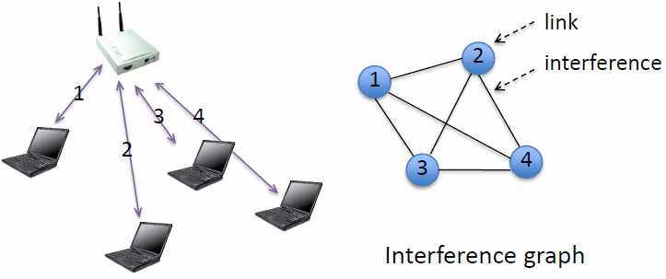

Introduction to 802.11 DCF
Single-cell 802.11 network
Every node interferes with the others.
Then CSMA synchronizes all nodes.
Non-backoff time-slots can simply be excluded from the analysis.
Backoff process is simple to describe
Every node in backoff stage k attempts transmission with probability p_{k}.
If it succeeds, k changes to 0; otherwise (collision), k changes to (k+1) mod (K+1) where K is the index of the highest backoff stage.
ATT
ATT
Stage 0
p₀
Population: N=4
No. stages: K=2 (0, 1, 2)
ATT
Stage 1
p₁
ATT
ATT
Stage 2
p₂
ATT
Time (slotted)
Idle
TX
Idle
Idle
Col
Idle
TX
Idle
Col

Slide 4
Decoupling Assumption
Each node is coupled with others in substance.
Decoupling Assumption → relaxing this coupling.
  Each node is independent from other nodes.
Conjecture: Is it correct as population tends to infinity?
Bianchi’s Formula (directly follows from the assumption)
Collision Probability
Avg. Attempt Probability
De facto standard tool for the analysis in the vast literature
“Valid until proved invalid”

Slide 5
Problem Statement
“Faulty until proved correct”, an excerpt from [SIM10]
We dare to question the validity of the decoupling assumption.
Consequence of relaxing the decoupling assumption
  The Markov chain is irreversible and hence does not lead to a closed-form expression of the stationary probability.
“For small values of K (e.g., 1 or 2),
the stationary distribution can be numerically computed.”
Quote from [KUM07]
Q: Decoupling assumption is valid?
  Exactly under which conditions?
[SIM10] A. Tveito, A. M. Bruaset, and O. Lysne, “Simula Research Laboratory – by Thinking Constantly about it”, Springer, 2009.
[KUM07] A. Kumar, E. Altman, D. Miorandi, and M Goyal, “New Insights from a Fixed-Point Analysis of Single Cell IEEE 802.11 WLANs”, IEEE/ACM Trans. Networking, June 2007.

Slide 6
Mean Field Approach – Essential Scalings
Population: N=4
No. stages: K=2 (0, 1, 2)
Stage 0
p₀
Stage 1
p₁
Stage 2
p₂
1. Intensity Scaling
2. Time Acceleration
3. N tends to infinity
Stage 0
q₀/N
Stage 1
q₁/N
Stage 2
q₂/N

Slide 7
Mean Field Approach
Recent advances in Mean Field Approach [SHA09][BOR10][BEN08]
  The Markov chain converges to the following nonlinear ODE.
  Equilibrium points of the ODE are the same to the solutions of Bianchi’s Formula.
Occupancy Measure
Stability of ODE ↔ Validity of Decoupling Assumption
[SHA09] G. Sharma, A. Ganesh, and P. Key, “Performance analysis of contention based medium access control protocols”, IEEE Trans. Information Theory, Apr. 2009.
[BOR10] C. Bordenave, D. McDonald, and A. Proutiere, “A particle system in interaction with a rapidly varying environment: Mean Field limits and applications”, Networks and Heterogeneous Media, Mar. 2010.
[BEN08] M. Benaim and J.-Y. Le Boudec, “A class of mean field limit interaction models for computer and communication systems”, Perf. Eval., Nov. 2008.

Slide 8
Outline
Introduction
Counterexample
    “Unique, But Not Stable”
Homogeneous System
    Derivation of an ODE: Done!
    Equilibrium Analysis: Uniqueness Condition
    Stability Analysis: Global Stability Condition
Heterogeneous System + AIFS Differentiation
    Derivation of a New ODE
    Equilibrium Analysis: Uniqueness Condition
Conclusion

Slide 9
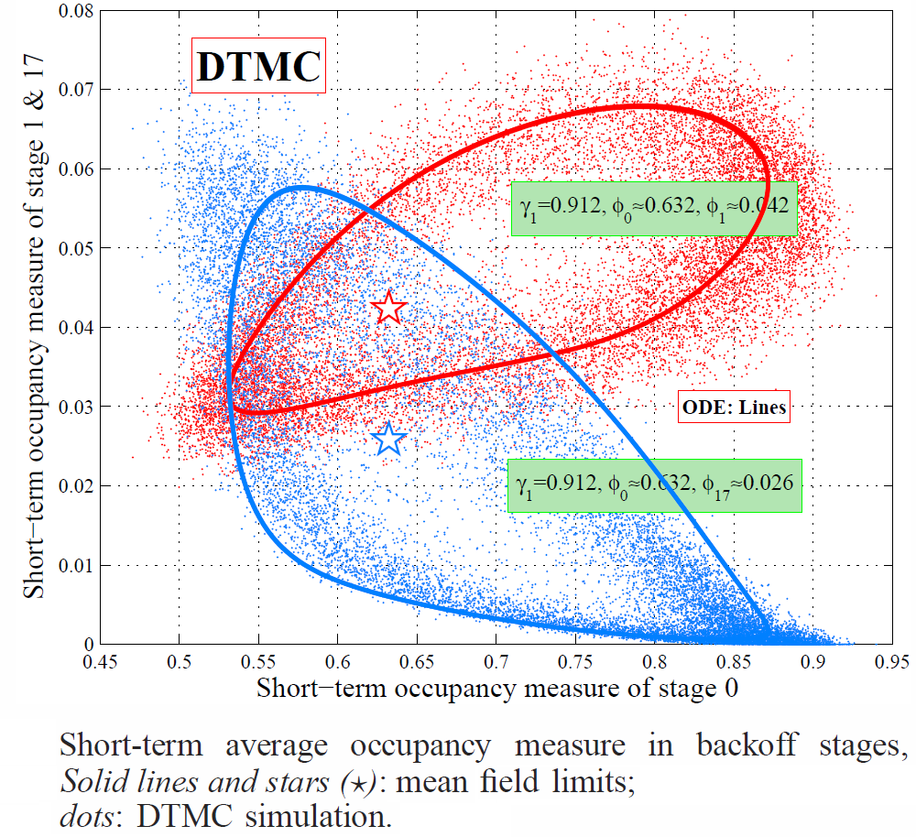
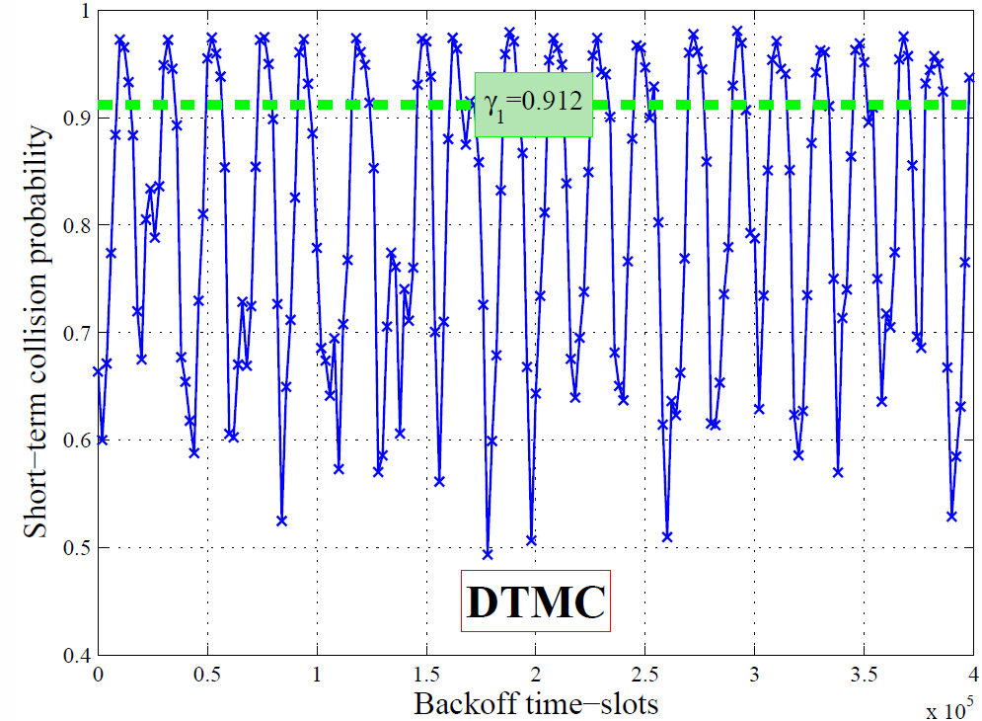
Selected Counterexample
A Limit Cycle in a Heterogeneous System with Two Classes and N=1280
Bianchi’s Formula has a unique solution

Slide 10
Homogeneous System: Equilibrium Analysis
Equilibrium analysis does NOT validate the decoupling approximation.
(UNIQ)
First Insight by [KUM07]
  (MONO) → (UNIQ)
(MINT)
(MONO)
A new implication:
(MINT) → (UNIQ)
(UNIQ) Bianchi’s Formula has a unique solution.
(MONO) q_{k+1}≤q_{k} : MONOtonicity of sequence q_{k}
(MINT) q_{k}≤1 : Mild INTensity
[KUM07] A. Kumar, E. Altman, D. Miorandi, and M Goyal, “New Insights from a Fixed-Point Analysis of Single Cell IEEE 802.11 WLANs”, IEEE/ACM Trans. Networking, June 2007.

Slide 11
Homogeneous System: Stability Analysis
Stability automatically implies (UNIQ).
(UNIQ)
The first stability condition:
  (MINT) → (Stability)
(Stability)
(Stability)
(MINT)
(MONO)
(UNIQ) Bianchi’s Formula has a unique solution.
(MONO) q_{k+1}≤q_{k} : MONOtonicity of sequence q_{k}
(MINT) q_{k}≤1 : Mild INTensity
Practical implication of the result
  (MINT) q_{k}≤1 gurantees that Bianchi’s formula provides a good approximation for large population.
(MINT) q_{k}≤1 validates the decoupling assumption.

Slide 12
Outline
Introduction
Counterexample
    “Unique, But Not Stable”
Homogeneous System
    Derivation of an ODE: Done!
    Equilibrium Analysis: Uniqueness Condition
    Stability Analysis: Global Stability Condition
Heterogeneous System + AIFS Differentiation
    Derivation of a New ODE
    Equilibrium Analysis: Uniqueness Condition
Conclusion

Slide 13

Heterogeneous System : New Challenge for Modeling
Heterogeneous System
  There are two or more classes.
Heterogeneous system → Multi-class differentiation (CW differentiation)
AIFS Differentiation
  A few time-slots are reserved for high-priority class.
AIFS Diff Δ=2
High
Priority Class Only
High
Priority Class Only
High
Priority Class Only
Time (slotted)
Idle
TX
RSV
RSV
Idle
Idle
Col
RSV
RSV
Idle
TX
RSV
Col

Slide 14
Generalized ODE model for 802.11
Why AIFS diff. complicates the analysis?
  [SHA09] reckoned “our analysis does not allow for AIFS differentiation”.
  The type of time-slot and occupancy measure depend on each other and hence increasing the state-space of the Markov chain.
Another insight from [BEN08] solves this problem.
Occupancy Measure
for Class H
Occupancy Measure
for Class L
[SHA09] G. Sharma, A. Ganesh, and P. Key, “Performance analysis of contention based medium access control protocols”, IEEE Trans. Information Theory, Apr. 2009.
[BEN08] M. Benaim and J.-Y. Le Boudec, “A class of mean field limit interaction models for computer and communication systems”, Perf. Eval., Nov. 2008.

Slide 15
Heterogeneous System: Equilibrium Analysis
Equilibrium of the generalized ODE coincides with that in [KUM07].
(UNIQ)
Similar implications:
(MONO)→(UNIQ)
(MINT) → (UNIQ)
(MINT)
(MONO)
We only conjecture that (MINT) implies the stability of the generalized ODE.
[KUM07] A. Kumar, E. Altman, D. Miorandi, and M Goyal, “New Insights from a Fixed-Point Analysis of Single Cell IEEE 802.11 WLANs”, IEEE/ACM Trans. Networking, June 2007.

Slide 16
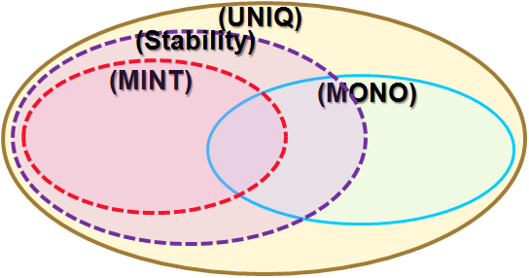
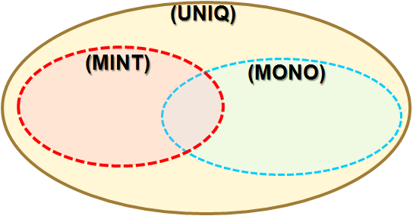
Conclusion
First Lesson to Learn : “Faulty until proved correct”
  We have been immersed in Bianchi’s Formula and its uniqueness.
  Counterexample where uniqueness does not lead to stability.
  Now is the time for us to explore the ordinary differential equation.
For Homogeneous System
(MINT) q_{k}≤1 guarantees that Bianchi’s formula provides a good approximation.
  This simplifies the whole story ➔ both uniqueness and stability
  This contrasts with previous speculation that (MONO) would suffice.
For Heterogeneous System
New ODE modeling multi-class and AIFS diff.
  New fixed point equation
  Still many challenging open problems on its stability.

