Slide 1

On the Shapley-like Payoff Mechanisms in Peer-Assisted Services with Multiple Content Providers
JEONG-WOO CHO
KAIST, South Korea
Joint work with
YUNG YI
KAIST, South Korea
April 17, 2011

Slide 2
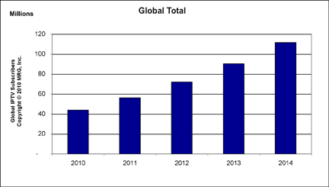





IPTV: Global Trend
IPTV : Watching Television via Internet
Fast Growth of IPTV
  Global IPTV market will rise to 110 million subscribers by 2014.
  Compound Annual Growth Rate (CAGR) is 24% between 2011-2014.
  South Korea has 2 million IPTV subscribers as of Jan. 2011.
  (Population: 49 million)
IPTV Service Providers
MRG Inc., “IPTV Global Forecast – 2010 to 2014”, Semiannual IPTV Global Forecast, Dec. 2010.
RNCOS Inc., “Global IPTV Market Forecast to 2014”, Market Research Report, Feb. 2011.

Slide 3
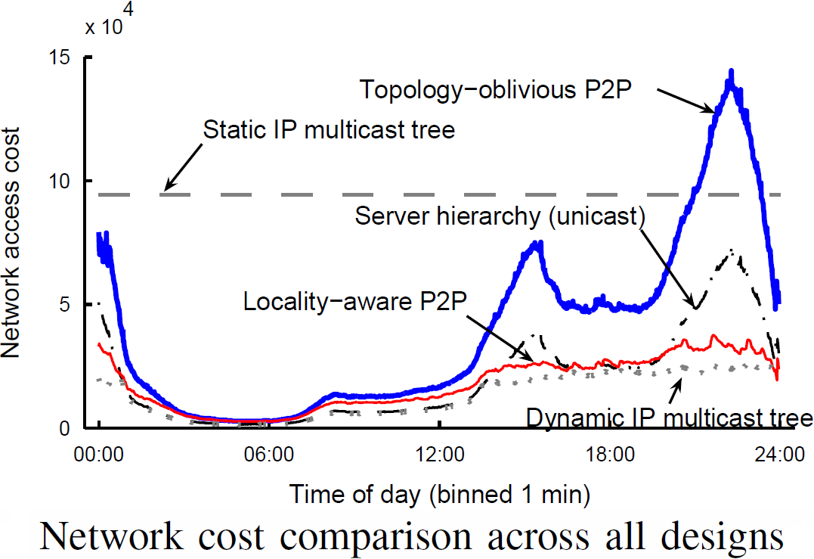
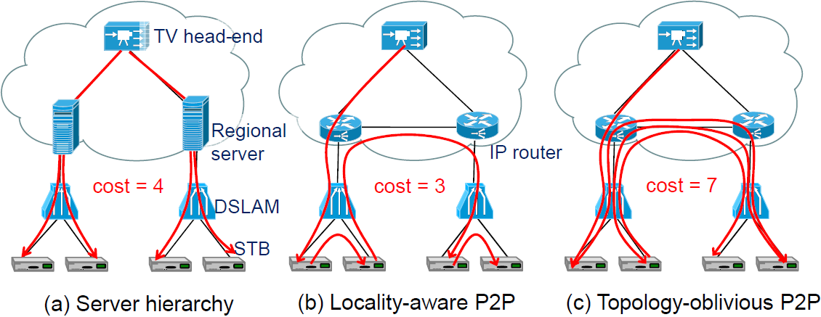
P2P: Potential for Cost Reduction
P2P can reduce the operational cost of IPTV. [CHA08]
  Cost: total amount of traffic between DSLAM and the first IP router
Dynamic IP multicast is the best solution but not implemented in routers.
The analysis based on a large-scale real trace shows the operational cost of IPTV can be significantly cut down (up to 83%) by P2P.
[CHA08] M. Cha, P. Rodriguez, S. Moon, and J. Crowcroft, “On next-generation telco-managed P2P TV architecture”, USENIX IPTPS, Feb. 2008.

Slide 4
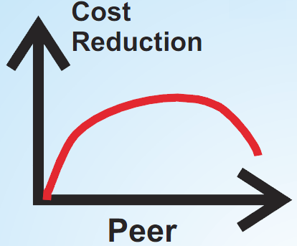



Viewing P2P in a New Light
BitTorrent: unprecedented success in terms of scalability, efficiency, and energy-saving.
Unfortunately, P2P nowadays is transmitting mostly illegal contents.
Hide-and-seek between content providers and pirates.
Can we exploit the virtues of P2P to create a rational symbiosis between content providers and peers?
Peer-Assisted Service [MIS10]: Coordinated legal P2P System
  Peers legally assist providers in distribution of legal contents.
  Hence, the operational costs of the content providers are reduced.
[MIS10] V. Misra, S. Ioannidis, A. Chaintreau, and L. Massoulié, “Incentivizing peer-assisted services: A fluid Shapley value approach”, ACM Sigmetrics, June 2010.

Slide 5

Incentive Structure of Peer-Assisted Services
Q: Will users (peers) donate their resources to content providers?
A: No, they should be paid their due deserts.
A quote from an interview of BBC iPlayer with CNET UK:
“Some people didn't like their upload bandwidth being used.”
$$$
We study in this paper
: An incentive structure in peer-assisted services when there exist multiple content providers.
: The case of single-provider was analyzed in [MIS10].
  We study Shapley-like payoff mechanisms to distribute the profit from the cost reduction.
  We use coalition game theory to analyze stability and fairness of the payoff mechanisms.
[MIS10] V. Misra, S. Ioannidis, A. Chaintreau, and L. Massoulié, “Incentivizing peer-assisted services: A fluid Shapley value approach”, ACM Sigmetrics, June 2010.

Slide 6
Outline
Introduction
Minimal Formalism
  Game with Coalition Structure
  Shapley Value and Aumann-Drèze Value
Coalition Game in Peer-Assisted Services
Instability of the Grand Coalition
Critique of the Aumann-Drèze Value
Conclusion

Slide 7

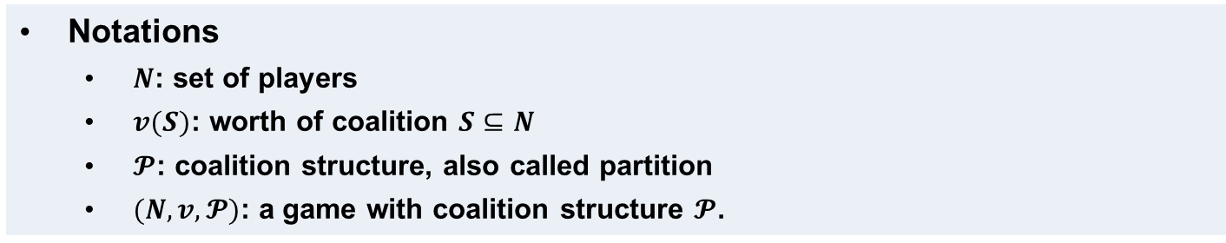






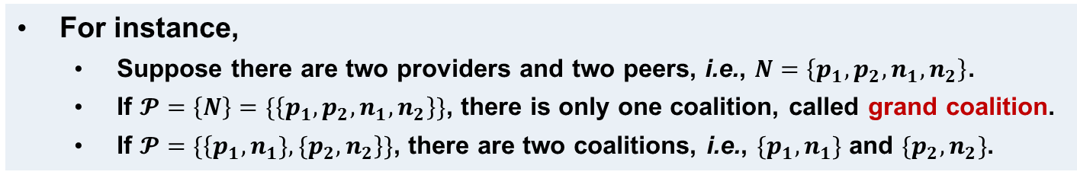

Game with Coalition Structure
Notations
  $N$: set of players
  $v(S)$: worth of coalition $S⊆N$
  $𝓟$: coalition structure, also called partition
  $(N,v,𝓟)$: a game with coalition structure $𝓟$.
For instance,
  Suppose there are two providers and two peers, i.e., $N=\left\{p_{1},p_{2},n_{1},n_{2}\right\}$.
  If $𝓟=\left\{N\right\}=\{\left\{p_{1},p_{2},n_{1},n_{2}\right\}\}$, there is only one coalition, called grand coalition.
  If $𝓟=\{\left\{p_{1},n_{1}\},\{p_{2},n_{2}\right\}\}$, there are two coalitions, i.e., $\{p_{1},n_{1}\}$ and $\{p_{2},n_{2}\}$.
Non-partitioned player set
Grand Coalition
Partitioned player set
$$p_{1}$$
$$p_{2}$$
$$p_{1}$$
$$p_{2}$$
$$n_{2}$$
$$n_{1}$$
$$n_{2}$$
$$n_{1}$$

Slide 8
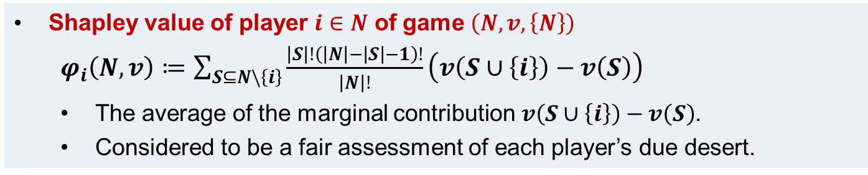
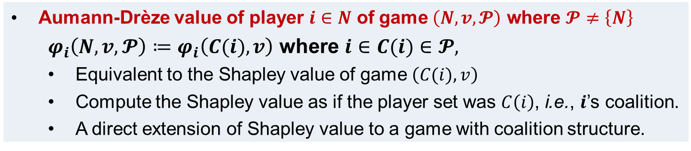
Shapley-like Values
Value (or a Payoff Mechanism)
  A worth distribution scheme.
  Summarizes each player’s contribution to the coalition in one number.
Shapley value of player $i∈N$ of game $\left(N,v,\left\{N\right\}\right)$
$φ_{i}\left(N,v\right)≔\sum_{S⊆N\backslash \left\{i\right\}}{\frac{\left|S\right|!\left(\left|N\right|−\left|S\right|−1\right)!}{\left|N\right|!}\left(v\left(S∪\left\{i\right\}\right)−v\left(S\right)\right)}$
  The average of the marginal contribution$v\left(S∪\left\{i\right\}\right)−v\left(S\right)$.
  Considered to be a fair assessment of each player’s due desert.
Aumann-Drèze value of player $i∈N$ of game $\left(N,v,𝓟\right)$ where $𝓟≠\left\{N\right\}$
$φ_{i}\left(N,v,𝓟\right)≔φ_{i}\left(C(i),v\right)$ where $i∈C(i)∈𝓟,$
  Equivalent to the Shapley value of game $\left(C(i),v\right)$
  Compute the Shapley value as if the player set was $C\left(i\right)$, i.e., $i$’s coalition.
  A direct extension of Shapley value to a game with coalition structure.

Slide 9
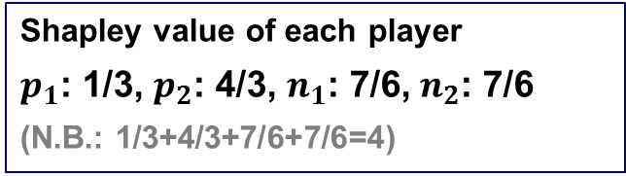
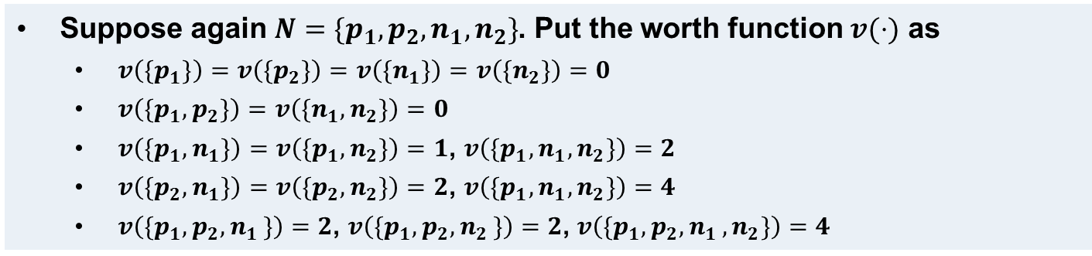




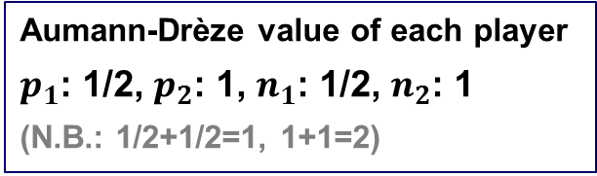
Toy Example
  Suppose again $N=\{p_{1},p_{2},n_{1},n_{2}\}$. Put the worth function $v(⋅)$ as
  $v\left({\{p}_{1}\}\right)=v\left({\{p}_{2}\}\right)=v\left({\{n}_{1}\}\right)=v\left({\{n}_{2}\}\right)=0$
  $v\left(\{p_{1},p_{2}\}\right)=v\left(\{n_{1},n_{2}\}\right)=0$
  $v\left(\{p_{1},n_{1}\}\right)=v\left(\{p_{1},n_{2}\}\right)=1$, $v\left(\{p_{1},n_{1},n_{2}\}\right)=2$
  $v\left(\{p_{2},n_{1}\}\right)=v\left(\{p_{2},n_{2}\}\right)=2$, $v\left(\{p_{1},n_{1},n_{2}\}\right)=4$
  $v\left(\{p_{1},p_{2}{,n}_{1}\}\right)=2$, $v\left(\{p_{1},p_{2}{,n}_{2}\}\right)=2$, $v\left(\{p_{1},p_{2}{,n}_{1},n_{2}\}\right)=4$
Non-partitioned player set
Grand Coalition
Partitioned player set
$$p_{1}$$
$$p_{2}$$
$$p_{1}$$
$$p_{2}$$
$$n_{2}$$
$$n_{1}$$
$$n_{2}$$
$$n_{1}$$
Worth = 4
Worth = 1
Worth = 2
Shapley value of each player
$p_{1}$: 1/3, $p_{2}$: 4/3, $n_{1}$: 7/6, $n_{2}$: 7/6
(N.B.: 1/3+4/3+7/6+7/6=4)
Aumann-Drèze value of each player
$p_{1}$: 1/2, $p_{2}$: 1, $n_{1}$: 1/2, $n_{2}$: 1
(N.B.: 1/2+1/2=1, 1+1=2)

Slide 10
Outline
Introduction
Minimal Formalism
Coalition Game in Peer-Assisted Services
  Worth Function
  Fluid Aumann-Drèze Value for Multiple-Provider Coalitions
Instability of the Grand Coalition
Critique of the Aumann-Drèze Value
Conclusion

Slide 11
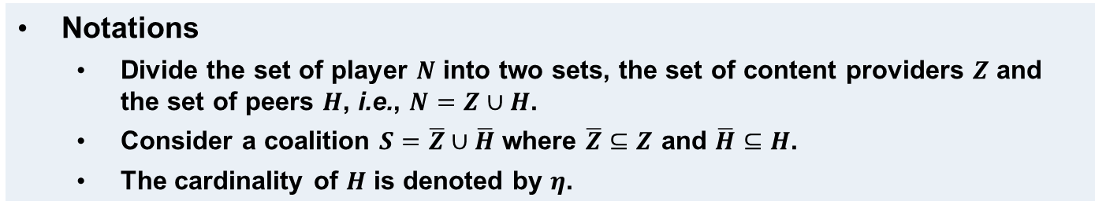
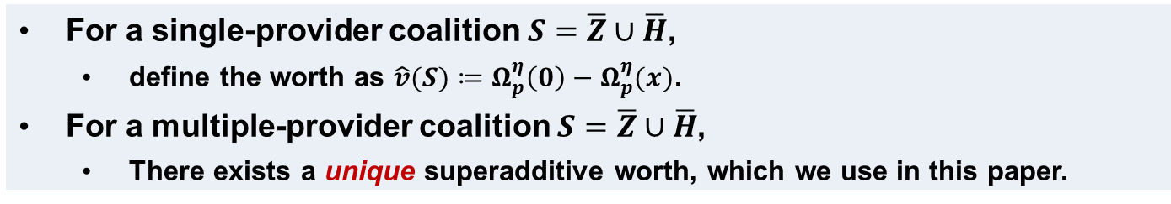
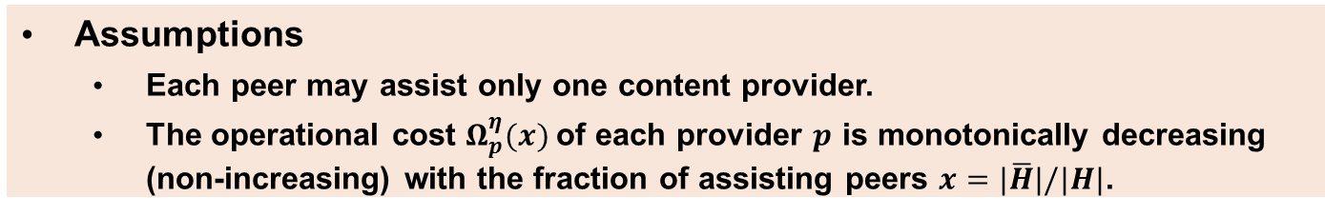
Worth Function in Peer-Assisted Services
How to define the coalition worth (cost reduction) in peer-assisted services?
Notations
  Divide the set of player $N$ into two sets, the set of content providers $Z$ and the set of peers $H$, i.e., $N=Z∪H$.
  Consider a coalition $S=\overline{Z}∪\overline{H}$ where $\overline{Z}⊆Z$ and $\overline{H}⊆H$.
  The cardinality of $H$ is denoted by $η$.
Assumptions
  Each peer may assist only one content provider.
  The operational cost $Ω_{p}^{η}(x)$of each provider $p$ is monotonically decreasing (non-increasing) with the fraction of assisting peers $x=|\overline{H}|/|H|$.
For a single-provider coalition $S=\overline{Z}∪\overline{H}$,
  define the worth as $\hat{v}(S)≔Ω_{p}^{η}\left(0\right)−Ω_{p}^{η}(x)$.
For a multiple-provider coalition $S=\overline{Z}∪\overline{H}$,
  There exists a unique superadditive worth, which we use in this paper.

Slide 12
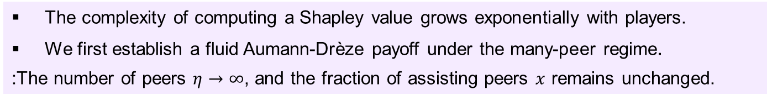
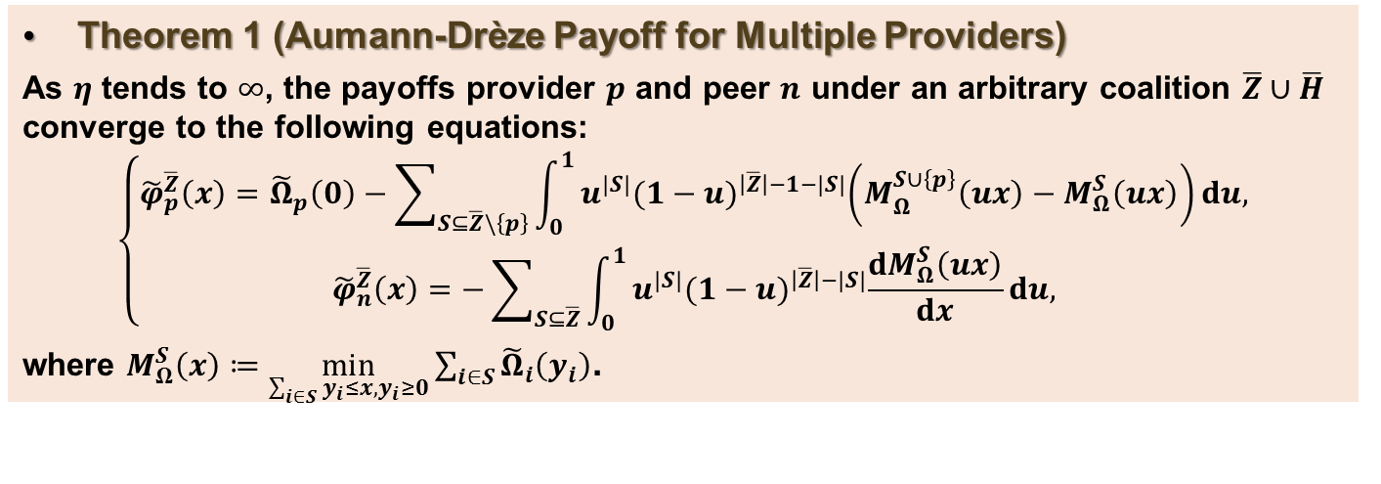
Fluid Aumann-Drèze Payoff
The complexity of computing a Shapley value grows exponentially with players.
We first establish a fluid Aumann-Drèze payoff under the many-peer regime.
  :The number of peers $η→∞$, and the fraction of assisting peers $x$ remains unchanged.
Theorem 1 (Aumann-Drèze Payoff for Multiple Providers)
As $η$ tends to $∞$, the payoffs provider $p$ and peer $n$ under an arbitrary coalition $\overline{Z}∪\overline{H}$ converge to the following equations:
$$\left\{\begin{matrix}{\tilde{φ}}_{p}^{\overline{Z}}\left(x\right)={\tilde{Ω}}_{p}\left(0\right)−\sum_{S⊆\overline{Z}\backslash \left\{p\right\}}{\int_{0}^{1}{u^{|S|}{(1−u)}^{\left|\overline{Z}\right|−1−|S|}\left(M_{Ω}^{S∪\left\{p\right\}}\left(ux\right)−M_{Ω}^{S}\left(ux\right)\right)du,}} \\ {\tilde{φ}}_{n}^{\overline{Z}}\left(x\right)=−\sum_{S⊆\overline{Z}}{\int_{0}^{1}{u^{|S|}{(1−u)}^{\left|\overline{Z}\right|−|S|}\frac{dM_{Ω}^{S}\left(ux\right)}{dx}du,}}\end{matrix}\right.$$
where $M_{Ω}^{S}\left(x\right)≔\min_{\sum_{i∈S}{y_{i}≤x,y_{i}≥0}}{\sum_{i∈S}{{\tilde{Ω}}_{i}\left(y_{i}\right)}}$.
A simplistic formula for Shapley-like payoff distribution scheme.
A generalized formula of the Aumann-Shapley (A-S) prices in coalition game theory

Slide 13
Outline
Introduction
Minimal Formalism
Coalition Game in Peer-Assisted Services
Instability of the Grand Coalition
  Shapley Value Not in the Core
  Aumann-Drèze Payoff Doesn’t Lead to the Grand Coalition
Critique of the Aumann-Drèze Value
Conclusion

Slide 14
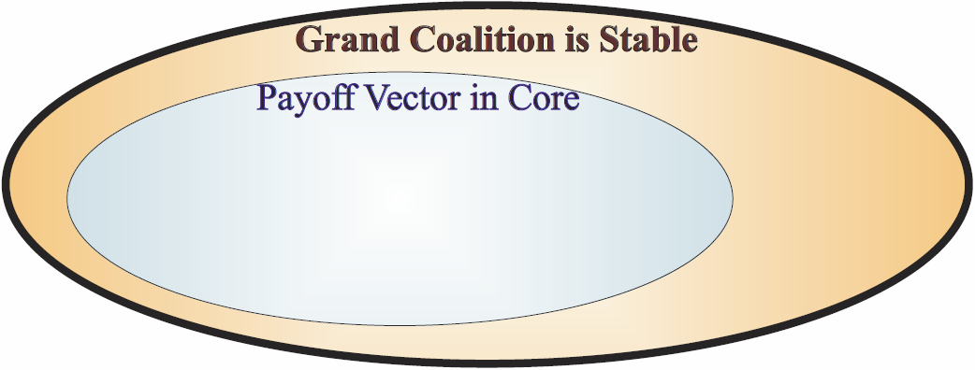
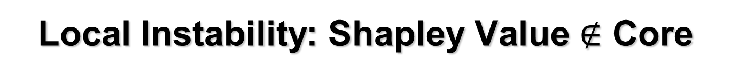
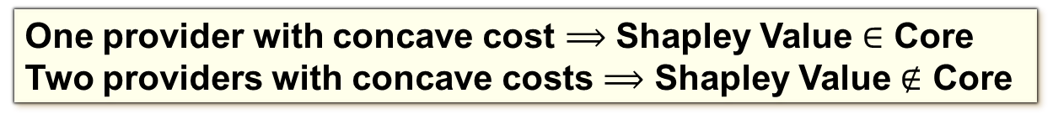
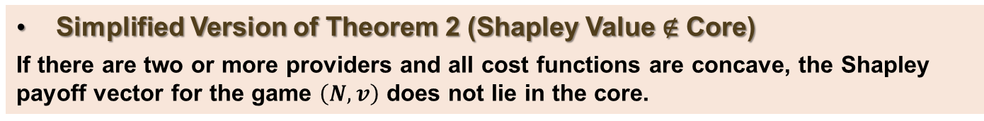
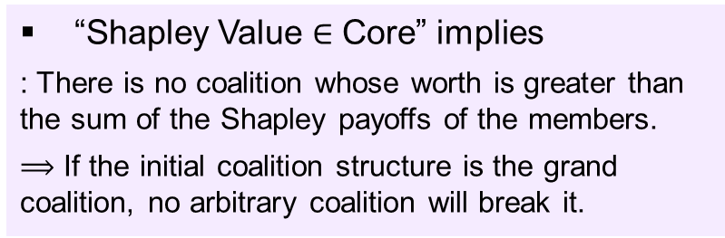
Local Instability: Shapley Value $∉$ Core
“Shapley Value $∈$ Core” implies
: There is no coalition whose worth is greater than the sum of the Shapley payoffs of the members.
$⟹$ If the initial coalition structure is the grand coalition, no arbitrary coalition will break it.
Simplified Version of Theorem 2 (Shapley Value ∉ Core)
If there are two or more providers and all cost functions are concave, the Shapley payoff vector for the game $\left(N,v\right)$ does not lie in the core.
A stark contrast to the single-provider case in [MIS10] where the Shapley payoff vector is proven to lie in the core.
In other words, the number of content providers matters.
One provider with concave cost $⟹$ Shapley Value $∈$ Core
Two providers with concave costs $⟹$ Shapley Value $∉$ Core
[MIS10] V. Misra, S. Ioannidis, A. Chaintreau, and L. Massoulié, “Incentivizing peer-assisted services: A fluid Shapley value approach”, ACM Sigmetrics, June 2010.

Slide 15
Convergence to the Grand Coalition
What happens if the initial coalition structure is not the grand coalition?
: Will the coalition structure converge to the grand coalition?
: To define the notion of convergence and stability, we introduce and use the stability notion of Hart and Kurz [HAR93].
Simplified Version of Theorem 3
If there are two or more providers, the grand coalition is not the global attractor.
Whether the Shapley value lies in the core or not, whether the cost functions are concave of not, the grand coalition is not globally stable.
[HAR83] S. Hart and M. Kurz, “Endogenous Formation of Coalitions”, Econometrica, vol. 51, pp. 1047-1064, 1983.

Slide 16
Outline
Introduction
Minimal Formalism
Coalition Game in Peer-Assisted Services
Instability of the Grand Coalition
Critique of the Aumann-Drèze Value
  Unfairness, Monopoly and Oscillation
Conclusion

Slide 17
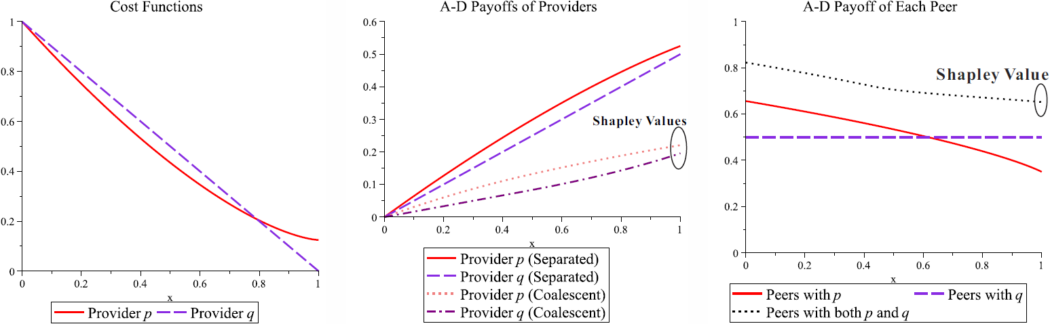
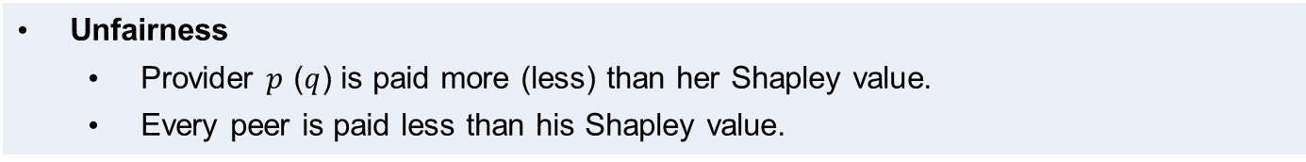
Critique of A-D Value: Unfairness
Our stability results suggest that if the content providers are rational (selfish), the grand coalition will not be formed, hence single-provider coalitions will persist.
We illustrate the weak points the A-D payoff when the providers are separate.
Example 1: When Two Providers Have Convex Costs
Unfairness
  Provider $p$ ($q$) is paid more (less) than her Shapley value.
  Every peer is paid less than his Shapley value.

Slide 18
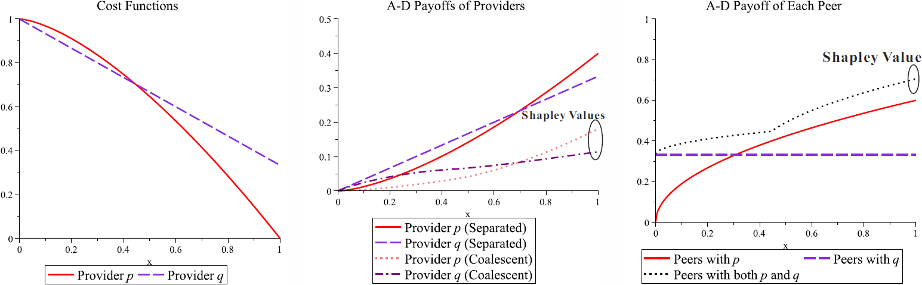
Critique of A-D Value: Monopoly
Example 2: When Two Providers Have Concave Costs
Monopoly
  Provider $p$ monopolizes all peers.

Slide 19
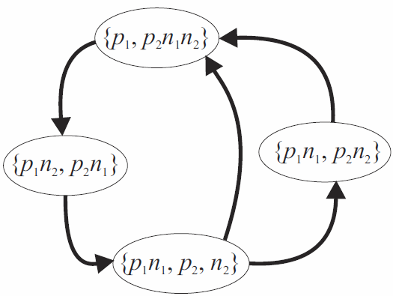
Critique of A-D Value: Oscillation
Relaxing the assumption of monotonicity of the cost functions, we can find an example which exhibits the oscillatory behavior of coalition structure.
There are two content providers and two peers in the following example.
Example 3: A-D Payoff Leads to Oscillatory Coalition Structure
Example 3: A-D Payoff Leads to Oscillatory Coalition Structure
Oscillation
  It is not yet clear how this behavior will be developed in large-scale systems.

Slide 20
Conclusion
Shapley-like Incentive Structures in Peer-Assisted Services
  A simple fluid formula of the Shapley-like payoffs for the general case of multiple providers and many peers.
A Lesson to Learn: “Conflicting Pursuits of Profits”
  Shapley value is not in the core.
  The coalition structure does not converge to the grand coalition.
  Providers tend to persist in single-provider coalitions.
More Issues for the Case of Single-Provider Coalitions.
  Providers and peers do not receive their Shapley payoffs.
  How to regulate the service monopoly? Do we have to?
  How to prevent oscillatory behavior of coalition structure?
Fair profit-sharing and opportunism of players are difficult to stand together.
: In our next paper, we have proposed a compromising and stable value (payoff).

