Slide 1
Frequent Route Based Continuous Moving Object Location- and Density Prediction on Road Networks
Gyözö Gidofalvi
Manohar Kaul
Christian Borgelt
Torben B. Pedersen
KTH – Royal Institute of Technology
Uppsala University
European Centre for Soft Computing
Aalborg University
Notes:
I am Gyozo Gidofalvi from KTH, Sweden. I am here to present joint work with my colleges from Uppsala University, Aalborg University and Spain. The title of our paper is Frequent Route Based Continuous Moving Object Location- and Density Prediction on Road Networks.

Slide 2
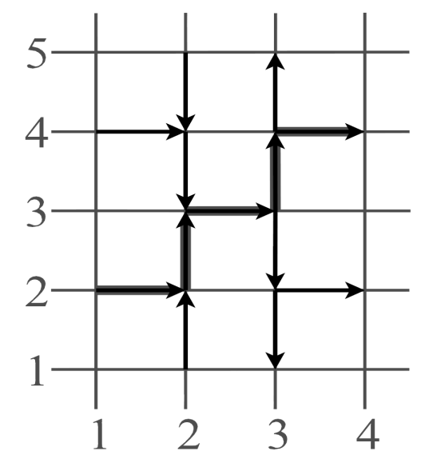
Problem Statement and Preliminaries
Aim: Given the current and historical movements of vehicles, predict their near-future location on the road network to:
Estimate near-future traffic conditions: (density / speed / flow)
Provide actionable travel information based on future estimates
Inform the relevant vehicles in case of an (actual / predicted) event
Suggest how and which vehicles to re-route in case of an event
(o1,1122,2,2)
(o1,2223,2,4)
(o1,2333,2,6)
Continuous movement on a road network (RN)
Map matching clients:
GPS → network location → trajectory piece
(oid, segment, traversal time, [arrival time])
RN trajectory = sequence of trajectory pieces
Trip trajectories
Stream of evolving trip trajectories
Closed Contiguous Frequent Routes (CCFR):
Closed → lossless compression of knowledge
Contiguous = ”no gaps” → effective prediction
Location prediction: What is the probability of o1 being on segment 3444 in 2 time units?
Density prediction: How many objects will be on segment 3242 in 2 time units?
?
Prediction time
Mining window
t
Notes:
So, given the current and historical movements of vehicles, we aim to predict their near-future location on the road network to: 1) estimate near-future traffic conditions and 2) provide actionable travel information based on the future estimates.
We assume map-matching clients that in an incremental and streaming fashion submit pieces of their road network trajectories to the server. Knowledge about the movement of a set of objects is represented in a compressed fashion as Closed Contiguous Frequent Routes (CCFR).

Slide 3
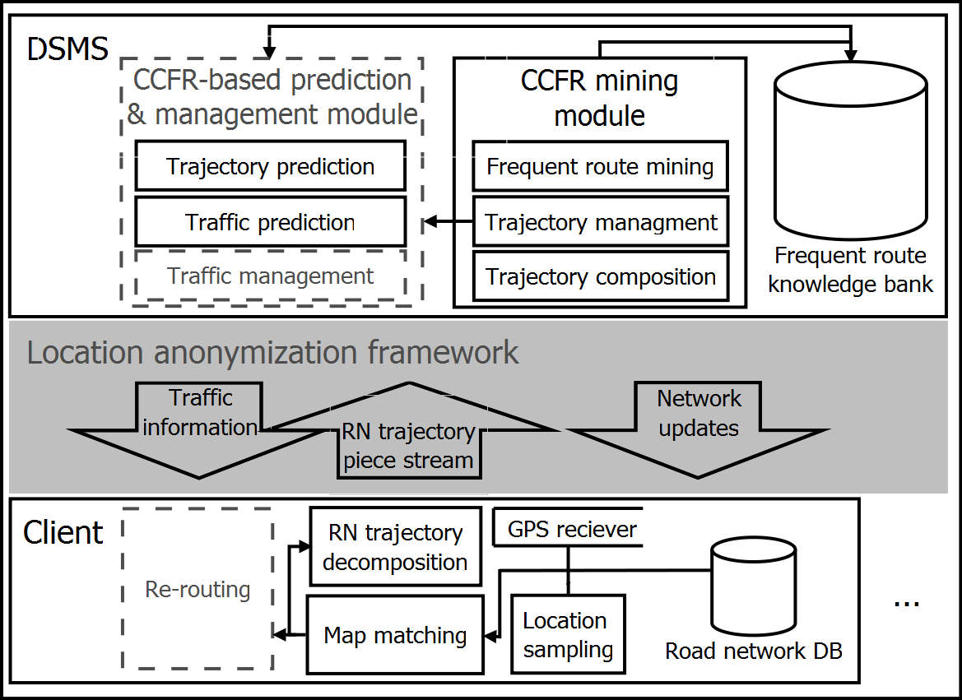
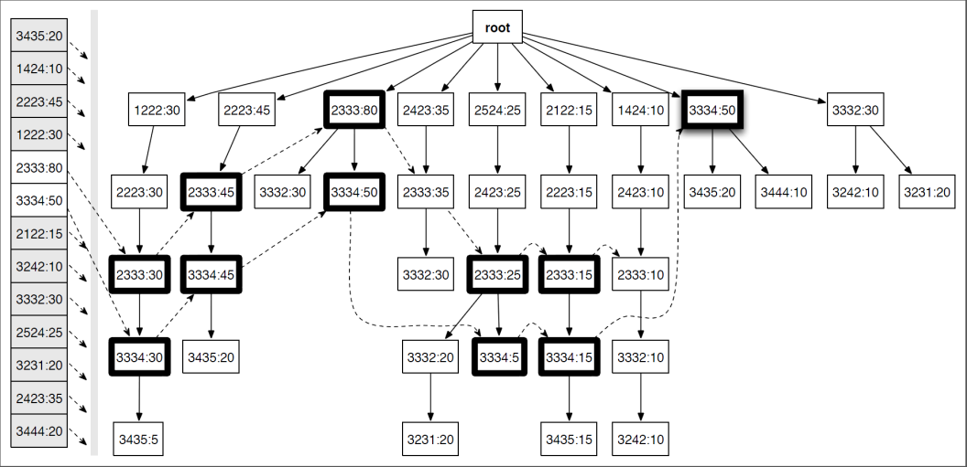
CCFR-Based Prediction
Mine and store CCFRs continuously.
Depth-first search
Closedness: direct check of pattern extension
Also calculate turn statistics
Retrieve and insert previously mined, relevant CCFRs in an FP-tree τ.
Given an object’s current trajectory qv:
Find the branches that ”best” match qv in τ.
(NOTE: Turn statistics guarantee a match)
Calculate the probability of each possible next segment from the closed pattern supports.
Distribute the the probability mass of the object proportional to the segment probabilities, extend qv, and recurse until the time horizon is reached.
Aggregate the predicted object locations at the time horizon → predicted network density.
Steps implemented as continuous queries in a DSMS
Notes:
We propose a client-server architecture, where the server has three main components: the CCFR mining module, the CCFR knowledge bank, and the CCFR-based prediction and management module. Components of the server are implemented as continuous queries in a Data Stream Management System (DSMS), in which the input stream is processed using the sliding window model.
We propose a location prediction model where the object’s current trajectory is matched to a set of CCFRs, which then in turn are used to estimate the probability of the next segment. Predictions further into the future are facilitated by recursively distributing the objects probability mass based on the estimates and extending the trajectory with the predicted segment until the prediction horizon is reached. Network densities are calculated by aggregating the probability masses for each segment at the prediction horizon.

Slide 4
Experiments and Results
Hardware: Macbook Pro, Intel Core 2 Duo 2.4 GHz CPU, 4MB L2 Cache, 800 MHz Bus speed, and 4GB memory
Data set: real-world trajectories of 1500 taxis and 400 trucks in Stockholm
Road network: 6000 directed, 55 meter long segments with a connectivity of degree of 2.3
17000 trip trajectories during the course of a day
Three groups of experiments:
Throughput and execution time of CCFR steam mining:
Even for large mining windows and very low support values the execution time is within real-time processing limits.
Scalability of the CCFR mining:
Mined approximately 25K CCFRs from 17K input trajectories at a minimum support of 0.1% in approximately 40 seconds. Scales nearly linear with the number of trajectories.
CCFR-based prediction accuracy:
Outperforms the “turn statistics only" approach and its additional utility becomes increasingly pronounced as the time horizon is increased.
Notes:
We evaluated our proposal on a 1 day long real-word trajectory data set of 1900 commercial vehicles which contains 17000 trips. We have found that the execution time for the proposed method is within real-time processing limits (<1 minute). Second, the method scales nearly linearly with the number of trajectories. Finally, the proposed method has a prediction accuracy that is 10-30% higher than the simpler turn-statistics based approach.

