Slide 1
Real-world validation of distributed network algorithms with the ASGARD platform
Oscar Tonelli, Gilberto Berardinelli, Preben Mogensen Aalborg University

Slide 2
Outline
Distributed algorithms for 5G: motivation for experimental PoC
Inter-cell interference coordination
  Live execution
  Offline execution
Distributed synchronization

Slide 3
Distributed algorithms for 5G networks
5G networks are expected to deal with the dense deployment of small cells in local area
  Unplanned interference
  Limited or non existing backhaul
Autonomous and distributed algorithms provide adaptive and flexible solutions for the network management
Three key areas for the development of distributed solutions are:
Inter-Cell Interference Coordination in frequency-domain (FD-ICIC)
Advanced Receivers for interference rejection and cancelling
Distributed Synchronization

Slide 4
Experimental proof-of-concept
The performance evaluation of distributed algorithms is sensitive to runtime execution aspects and topology characteristics of the network deployment
Simulation-based studies should be verified experimentally
The validation of distributed network algorithms requires to consider a sufficiently large amount of wireless links.
Development of a network testbed based on Software Defined Radio (SDR) hardware
Optimization of configuration and decision-making parameters
Verify the system implementation and live execution
Analysis of network deployments in realistic conditions
FD-ICIC/Synchronization/Advanced Receivers

Slide 5
Outline
Distributed algorithms for 5G: motivation for experimental PoC
Inter-cell interference coordination
  Live execution
  Offline execution
Distributed synchronization

Slide 6



Inter-Cell Interference Coordination
Mechanisms for mitigating the interference problem by dynamically adjusting the allocation of spectrum resources in the cells
Common characteristics of distributed RRM processes for ICIC:
  Autonomous decision-making processes
  Spectrum sensing/RSRP measurements
  Explicit coordination
Initial activities at AAU focused on the Autonomous Component Carrier Selection Algorithm (ACCS)
Goal of validation: verify SINR improvements at the users in the cells
Two approaches:
  Live system execution
  Offline analysis / Hybrid simulaton
Interference
Signal
User
Acces Point

Slide 7
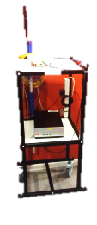
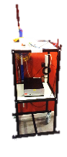
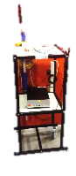
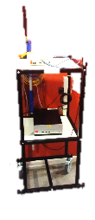
Live system execution on the testbed
Dynamic Channel Propagation
Mobility Aspects
Runtime Errors
Execution Delays
Performance results
Most accurate representation of a real network
System features of interest are directly implemented and executed on the testbed nodes
The testbed is limited in size
Difficult to cover a large amount of deployments
Difficult to repeat experiments, hard to implement

Slide 8
”Offline” analysis – Hybrid Simulation
Link measurements in static propagation conditions
Multiple Network Deployments
System-level simulator
Performance results
Aims for an extensive analysis of the network topology and deployment scenarios
Multiple inter-node path loss measurements are performed over a large set of positions
Enables repeatable studies exploting existing system-level simulators
The static channel propagation assumption strongly limits the applicability of the studies

Slide 9
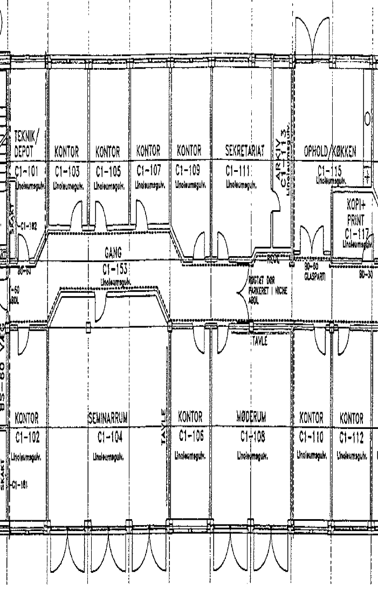
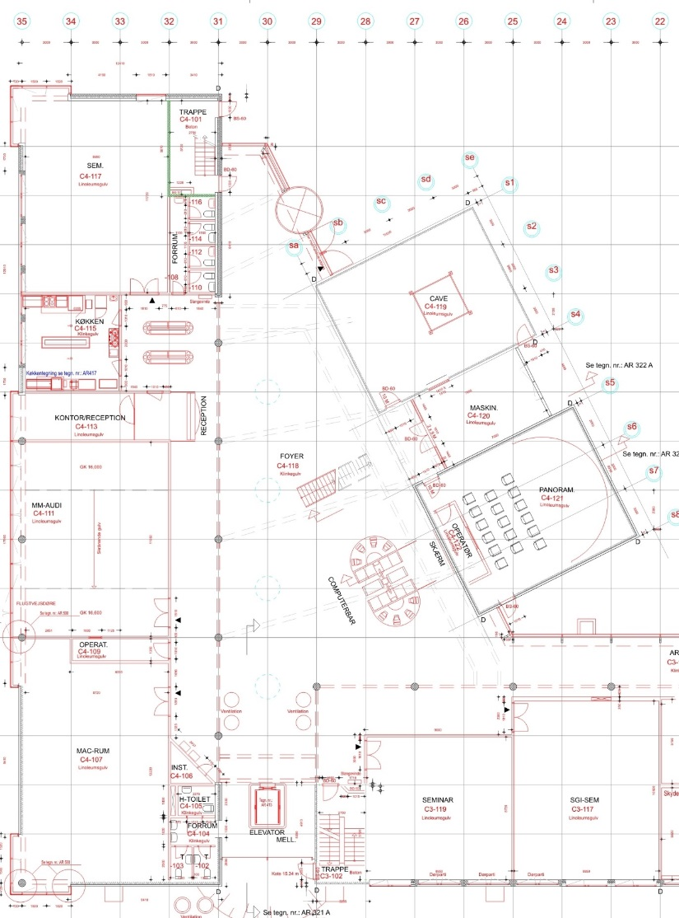
Indoor measurement campaigns for ”offline” network analysis
cm
Objective: link path loss measurements
Individuate a number of location in the target deployment scenario
First campaign in office scenario, 990 measured links.
Second campaign in open-area/mall scenario, 1128 measured links.

Slide 10
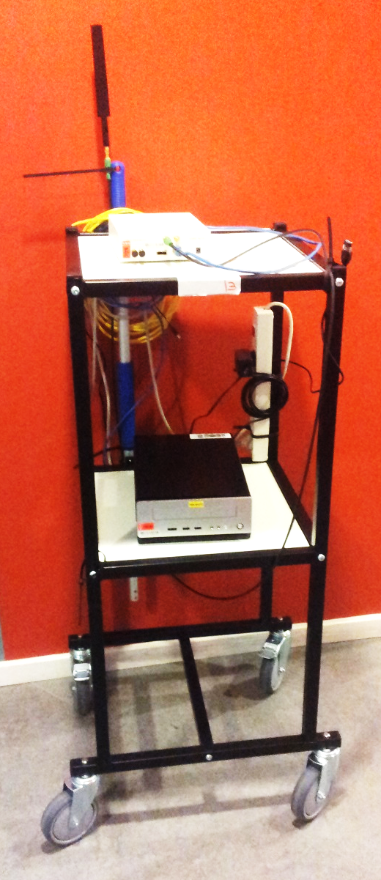
Testbed setup and TDD based measurements
Node 1
Node 2
Aggregates measurements in time, from multiple testbed nodes
+
=
CC1
CC2
Performs RSRP measurement per spectrum chunks (CCs), in respect to the transmitting node. Averages in time over multiple blocks of data
CC3
CC...
Block of FFT-size samples
Selects the valid blocks of samples
Acquires samples
RX
RX
TX
TX/RX Frame

Slide 11

System Implementation on the ASGARD platform
ChannelSounderApp
Module A
TCP
Socket Client Interface
SendLogData
TDD Frequency Switch Controller
DataEvent <SensingObject>
AllFreqDone
Event
Time Division Sensing
Module B
SetSTartTime()
Testbed Server
SensingObject
Sensing Component
Node X
Node Y
Valid Rx Samples
itpp::cvec
StartTime
Data Selector
Module D
TDD Vector Buffer
TX Signal
RX Samples
Tts<int16_t>
Configuration (Frequency)
UHD Communication
Module E

Slide 12
ACCS Performance results
Comparing to reference studies in the 3GPP dual stripe scenario
Normalized cell throughput results
Scheme | Scenario | Outage | Avg | Peak
Reuse 1 | NJV12 | 6.6% | 29.7% | 60.8%
 | Dual Stripe 20% DR* | 5% | 60% | 100%
 | Dual Stripe 80% DR* | 0.9% | 21% | 64%
ACCS | NJV12 | 18% | 33.3% | 65.8%
 | Dual Stripe 20% DR* | 19% | 66% | 100%
 | Dual Stripe 80% DR* | 12% | 30% | 59%
G-ACCS | NJV12 | 15.1% | 33.3% | 79.4%
 | Dual Stripe 20% DR* | 17% | 70% | 100%
 | Dual Stripe 80% DR* | 6% | 32% | 72%
* from: L. G. U. Garcia, I. Z. Kovács, K. I. Pedersen, G. W. O. Costa and P. E. Mogensen, "Autonomous Component Carrier Selection for 4G Femtocells - A Fresh Look at an Old Problem," IEEE Journal on Selected Areas in Communications, vol. 30, no. 3, pp. 525-537, April 2012.

Slide 13
Outline
Distributed algorithms for 5G: motivation for experimental PoC
Inter-cell interference coordination
  Live execution
  Offline execution
Distributed synchronization

Slide 14
Distributed Synchronization
Time/frequency synchronization among neighbor APs is an important enabler of advanced features such as interference coordination/ suppression.
We developed distributed synchronization algorithms based on exchange of beacon messages among neighbor nodes.
Upon reception of a beacon, the AP updates its local clock according to a predefined criterion.
A
A
time
B
C
B
time
C
time
D
D
time

Slide 15
Distributed Synchronization
Focused on runtime synchronization, i.e. how to maintain time alignment in the network despite of the inaccuracies of the hardware clocks.
The initial synchronization is based on the Network Time Protocol (accuracy at ms level)
  → beacons are round robin scheduled with ms level accuracy (coarse synchronization)
Node 1
Node 2
Node 3
Node 4
Node 1
Node 2
Node 3
Node 4
Inter-beacon
time
time
expected time
effective time
Time
misalignment
Goal: achieving tens of µs level time misalignment

Slide 16


Distributed synchronization demo
8 nodes
Inter-beacon time: 0.2048 seconds
TXCO Clock precision on the USRP N200 boards: ~1-2.5 PPM
Sample rate: 4 Ms/s
Beacon type: CAZAC sequence
Beacon detection based on correlator
Running
the demo…

