Slide 1
On Optimization of Quality of User Experience and Wireless Network Bandwidth in Video Content Delivery
Alisa Devlić
December 4th 2015.

Slide 2
Agenda
The problem
Market trends
Research questions
Exploration space and approach
Key concepts and results
How everything fits together?
Conclusions

Slide 3
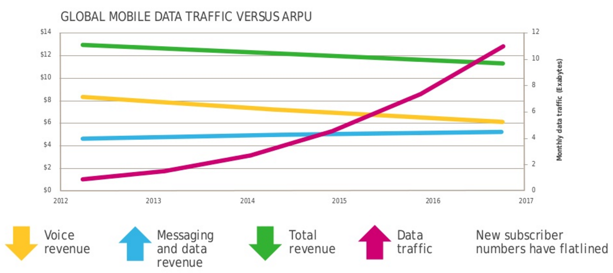
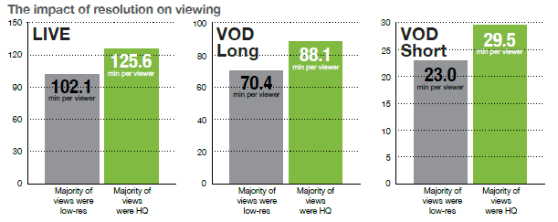
The Problem
1. Operators’ revenue gap
2. Poor video quality threatens viewers’ experience
Picture source: The six degrees of mobile data plan innovation, Alcatel Lucent 2014
which affects video content providers’ business
Picture source: Conviva report 2012.
3. Increased mobile device energy consumption
Notes:
The explosive growth of mobile data traffic strains capacity of operators networks, which threatens video quality perceived by end users. The revenues from mobile data services are decreasing and cannot support the network investments that are needed to support this increasing traffic growth.
In 2012, around 60% of all streams experienced quality degradation: buffering interruptions, slow video startup, and low resolution picture quality. On the right figure we can see how poor video quality decreases the viewing time of video content. Viewers have become impatient about video quality degradations, they abandon the streaming and move to another source if they are unhappy about the video quality.
An increased consumption of mobile data services and network signaling caused the increase of mobile device energy consumption, which decreases operational time of mobile device.

Slide 4
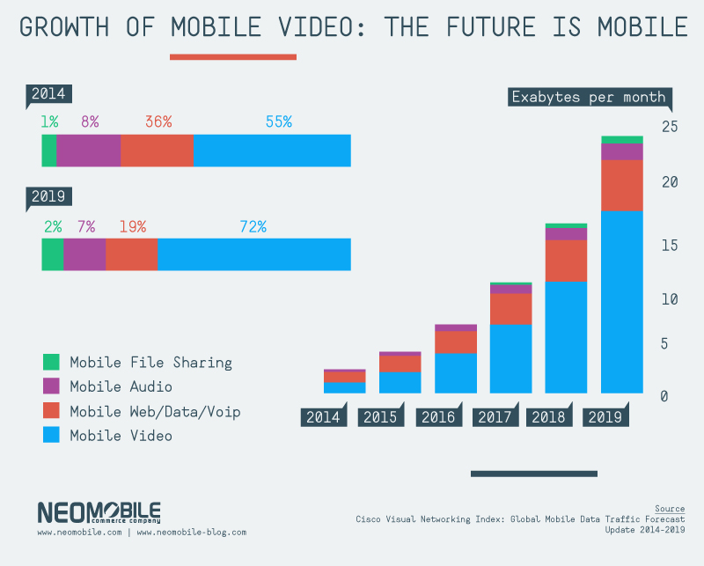
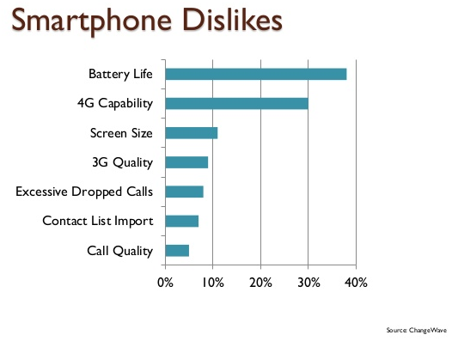
Market Trends
every year mobile video traffic doubles!
72% mobile video by 2019.
Operational time is the least satisfying aspect of smartphones
Notes:
Majority of mobile data traffic increase is cased by growing popularity of mobile video services, such as YouTube and Netflix, which are all delivered over-the-top (OTT) to mobile devices, without being optimized for transfer over mobile network.
Every year the mobile video traffic doubles and it is expected that 72% of mobile data traffic will be video by 2019.
Another trend that we all have observed is shorter battery life, which has become the least satisfying aspect of smartphones.

Slide 5
The Research Questions addressed in the thesis
Can we optimize video content for desired constant perceptual video quality in a programmatic manner, while reducing the video file size?
Can streaming of an optimized video to a user’s mobile device reduce video quality degradations experienced by Dynamic Adaptive Video Streaming over HTTP (DASH), while consuming fewer bits?
Can opportunistic context-aware prefetching reduce energy consumption of mobile video delivery compared to on demand download?
How to enable applications to discover, collect, and adapt to a new context information in timely and energy-efficient manner?
Notes:
To address these market challenges (of increased mobile video traffic load, poor video quality experience, and increased device energy consumption), we investigated the following research questions in the thesis.

Slide 6
The exploration space and approach
  Identified need for:
    reducing per video wireless bandwidth
    optimizing mobile users’ viewing experience
    reducing energy consumption of mobile video delivery
  Proposed solutions:
    Video optimization
    QoE-aware adaptive video streaming
    Context-aware mobile video prefetching
PhD thesis
60% reduced video size without perceptible quality difference
more stable video quality than DASH, consuming fewer bits
20-70% energy cost reduction
Notes:
We proposed the following three solutions:
video optimization that reduces the video size up to 60% without perceptible quality difference, thus reducing per video wireless bandwidth and optimizing mobile users’ viewing experience
2) QoE-aware adaptive video streaming that provides more stable video quality than the existing adaptive video streaming by streaming optimized videos which are reduced in size, thus consuming fewer bits and reducing energy consumption of mobile video delivery, while optimizing the mobile users’ viewing experience
3) context-aware mobile video prefetching that downloads videos on higher data rates than using on demand download, thus decreasing the duration of mobile data transfer and reducing energy consumption by up to 20-70%, depending on the pattern of user’s achievable data rates. By playing the prestored video from the terminal memory without virtually no interruptions and delays, content prefetching improves the users’ viewing experience.

Slide 7












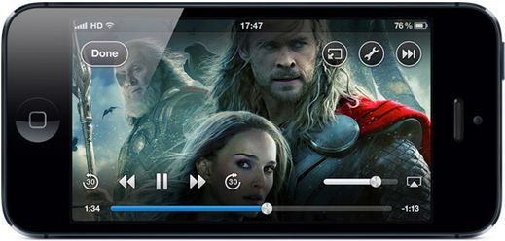
Perceptual video quality varies through video content
Research question 1:
Can we optimize video content for desired constant perceptual video quality in a programmatic manner, while reducing the video file size?
MOS scale
Video₁(360p)
Video₂(360p)
Video₃(720p)
Video₄(480p)
2.6
<<
3.2
4.4
=
4.4
20% larger size
Samsung Galaxy S3
Max supported resolution: 1280x720 (720p)
2x larger size!
Videos in existing qualities are not optimized for perceptual video quality and their sizes can greatly differ!
Notes:
The perceived video quality varies through video content, despite being encoded for the particular resolution and video bitrate, due to the nature of video content that changes from one scene to another.
We found by experiments that different video clips at the same resolution can vary substantially in the perceived video quality, given by Mean Opinion Scores that range from 1 to 5, with 1 representing the lowest and 5 representing the highest video quality. Video 1 is given MOS grade 2.6 while video 2 is given MOS 3.2 for 20% larger size – AmazingSpiderman and Ted (1.4 and 1.7 MB) . In another example, two videos at different resolutions are given the same grade, while video in the higher (720p) resolution has 2 times larger file size than the video in the lower (480p) resolution – TwilightSaga2 and HungerGames.
These results tell us that video clips encoded in the existing video qualities are not optimized for the perceived video quality, while their file sizes can greatly differ.

Slide 8
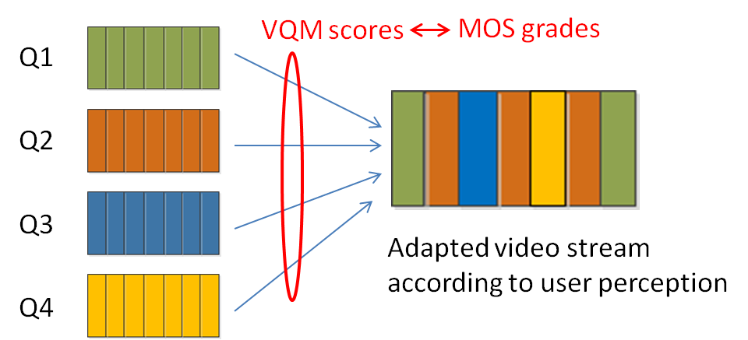
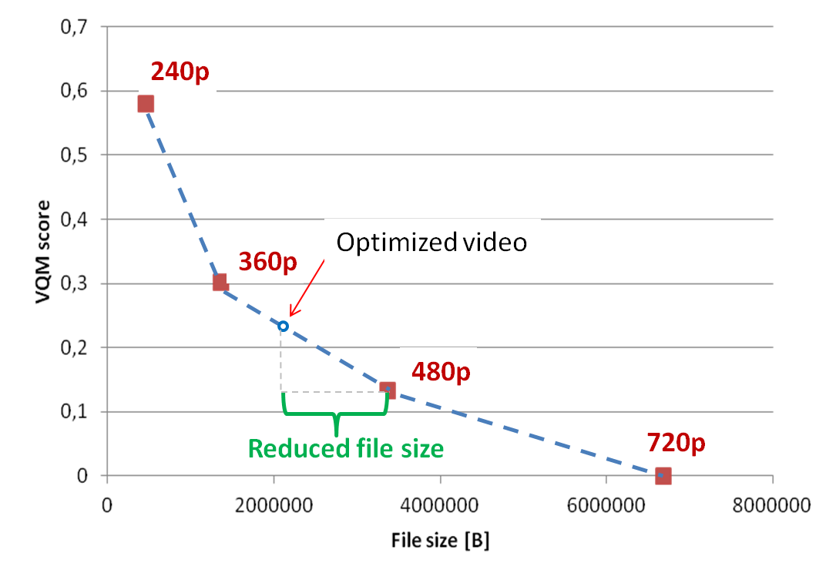
Human- and content-aware video optimization
Non optimized video
Optimized video
60% video size can be reduced …
… with no perceptible difference to the viewer
70% video size can be reduced…
… with perceptible, but not annoying difference to the viewer
Notes:
By removing quality oscillations from the video, constant perceptual video quality can be maintained through the entire video, while reducing its size.
This represents our approach of human- and content-aware video optimization that deliberately downscales resolution of video frames on a mobile device screen where users cannot see a difference in perceptual video quality compared to the original video source, or can see a difference to a limited extent in order to get larger video size reductions.
The optimized video typically resides between two existing qualities with the video quality metrics score and the file size. Video quality metrics score represents the perceptual quality difference on the scale from 0 to 1, with 0 being closest to the original video source. The file size reduction is then computed compared to the higher of the two existing video qualities (as on the example in figure shown 480p).
With this approach and using large panel of users evaluating the perceptual video quality, we obtained up to 60% video size reductions with no perceptible difference to the viewer and up to 70% with perceptible, but not annoying difference to the viewer, which corresponded to MOS grades of 4.5 and 4, respectively.

Slide 9
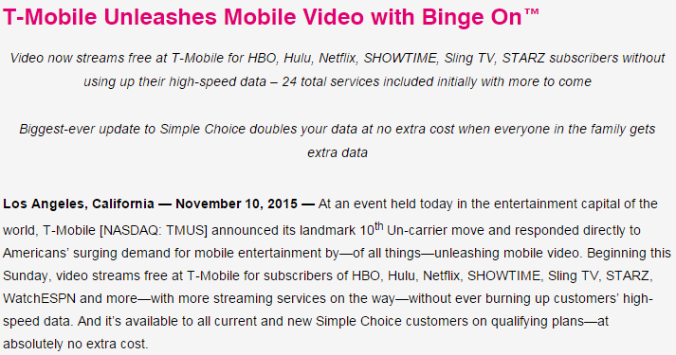
Video optimization can save additional 35-70% bandwidth to T-Mobile!
Notes:
This advertisement represents the actual attempt of a mobile operator to reduce the mobile video traffic load: T-Mobile has recently announced a new service Binge On offered to their mobile users that streams videos over mobile networks in 480p quality, downscaled from 1080p. With this service they are claiming that they can offer 3x more videos to users for the same data plan, while optimizing videos for the mobile device screens. In fact they are not optimizing the perceptual video quality, which depends on the particular mobile device, instead they are simply not downgrading the streaming quality to lower resolutions and bitrates.
With our video optimization approach we can provide additional 35-70% of bandwidth savings to T-Mobile compared to their 480p quality, without compromising the viewing experience.

Slide 10
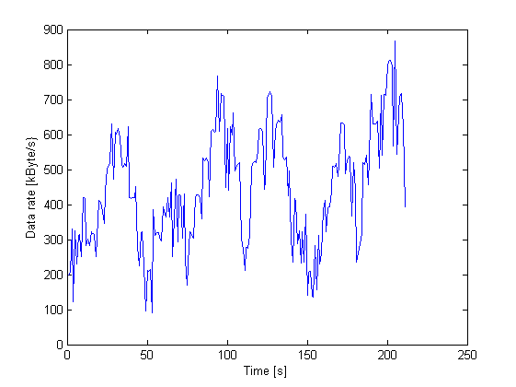
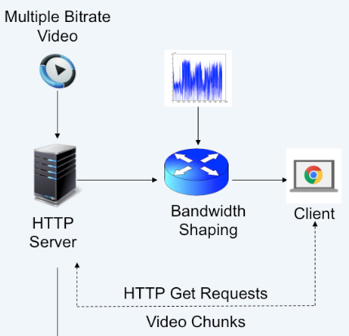
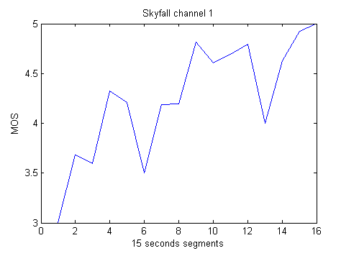
Video quality degradations experienced during adaptive video streaming over varying mobile data rate channel
Research question 2:
Can streaming of an optimized video content to a user’s mobile device reduce video quality degradations experienced by DASH, while consuming fewer bits?
4 minute Skyfall video
Notes:
Mobile users experience deteriorations of video quality during the existing Dynamic Adaptive Streaming over HTTP (DASH) over a varying mobile network channel, which can degrade a viewers’ QoE. DASH tends to maximize bitrates of individual video segments, which results in high amplitude of video quality variations, as shown in the bottom figure.
The question is, if by streaming an optimized video in constant perceptual video quality over the varying mobile data rate channel, we can reduce video quality degradations experienced by DASH and consume fewer bits?

Slide 11
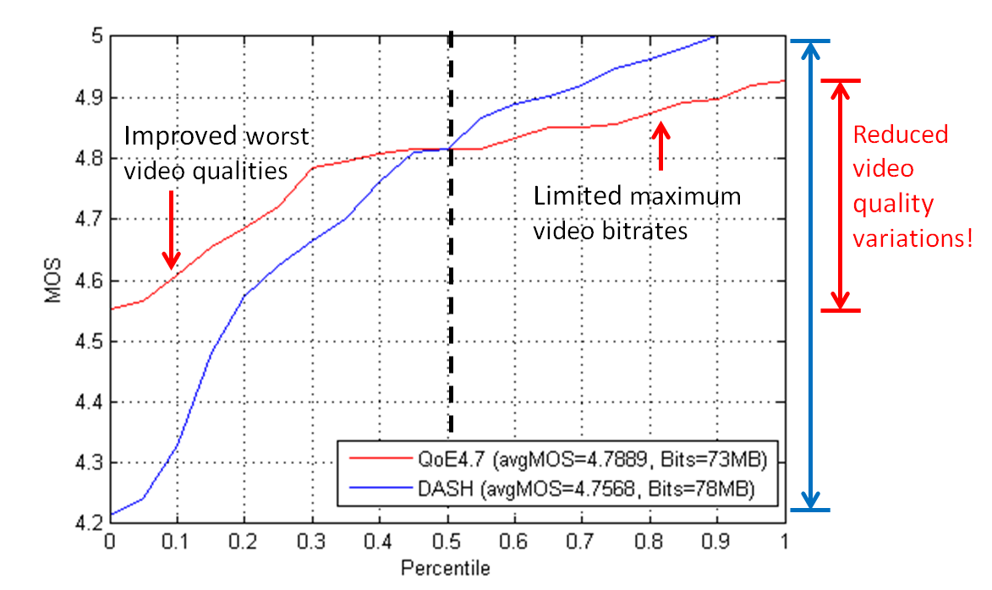


QoE-aware adaptive video streaming
Estimated data rate
Optimized video’s bitrates
Quality gain
Remaining bandwidth is used to prefetch future seconds of optimized video stream
Notes:
The proposed QoE-aware adaptive video streaming streams an optimized video in the constant perceptual video quality that is supported by network conditions, using the remaining bandwidth to prefetch future seconds of optimized video stream.
This streaming is run over DASH, and switches to lower qualities in case a video segment can be downloaded until the end of next second and there are no remaining bits in the buffer. However this should not occur so frequently, since an optimized video quality is carefully chosen to reflect statistical properties of available bandwidth.
By limiting the maximum bitrates of individual video segments and prefetching the optimized video in advance of playout, this method improves the worst video qualities introduced by DASH and reduces amplitude of video quality variations, while reducing bandwidth.
It has been shown that users are more sensitive to quality degradations than they appreciate quality improvements, therefore quality of streaming video will be better perceived by increasing the lowest video quality than by increasing any other higher quality level.

Slide 12


Impact
20-60%
improved the lowest video qualities ….
…of DASH
40%
bandwidth savings to deliver superior perceptual quality
OR
60%
bandwidth savings to deliver the same perceptual quality
2-3X
more videos can be streamed with the same data plan
≈ 1.7 million US dollars cost reduction to Netflix per week!
Notes:
After running the DASH and QoE-aware streaming over the same videos and data rates in the controlled laboratory environment, we show the following results:
that our proposed streaming can improve up to 20-60% of lowest video qualities experienced by DASH
it can save up to 60% bandwidth to operators by delivering the same perceptual quality as DASH or deliver the superior video quality, while saving up to 40% bandwidth
With these figures up to 2-3x more videos can be provided to mobile users for the same data plan
And up to 1.7 million US dollars can be saved per week to content providers.

Slide 13




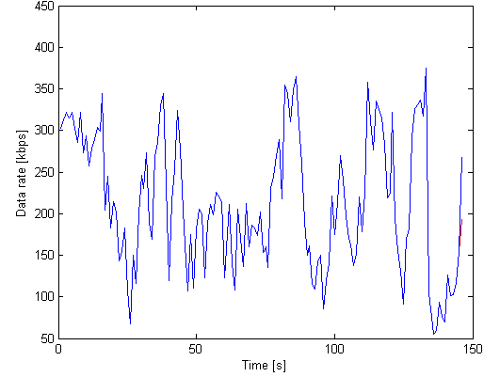
Energy consumption of mobile data delivery
Energy=f (time)
Internet
Research question 3:
Can opportunistic context-aware prefetching reduce energy consumption of mobile video delivery compared to on demand download?
15 min YouTube video
~300MB
Notes:
It has been known that energy consumption in mobile devices that is related to mobile data transfer linearly increases with the duration of data transfers over the radio interface, which depend on the download data rates achievable by the device.
Therefore, the transfer of 15 min YouTube video over the varying mobile data rate channel can take different time (from 30 till 15 minutes) depending on which data rates the content has been downloaded (150kB/s or 300kB/s), thus affecting the device energy consumption.
The question is if the opportunistic context-aware prefetching can reduce energy consumed for mobile video delivery compared to on demand download.

Slide 14
Context-aware mobile video prefetching
Downloading time
Prefetching SLA
Prefetching
SLA
ˆ
ω
R
ˆ
R
Download
∑
=
Prefetching cost
start
τ
Content
Prefetching
Download
Prefetching
Content
Prefetching
S
=
Prefetching cost
Prefetching
available
start
completed
completed
available
start
completed
Operator-like prefetching (OP PRE)
Over-the-Top prefetching (OTT PRE)
PRE parameter: Target prefetching data rate (ˆR)
OTT parameters: wake up time (ω) and sleep time (τ)
Notes:
The idea of context-aware mobile video prefetching is to exploit times and locations with high data rates to deliver the video content before the user requests it, thus potentially reducing the energy consumption of video delivery, and improve the user’s experience by playing the prestored video from the device’s memory with virtually no perceived interruptions or delays.
We propose 2 prefetching methods that prefetch the content on data rates that are equal to or greather than the given threshold. They differ based on how they obtain a user’s data rates:
Operator-like prefetching has complete knowledge of user’s connectivity and data rates, which represents ideal view that is closest to a mobile operator.
Prefetching cost is defined as the time spent actively prefetching the content, while prefetching SLA represents the duration from the start to the end of prefetching. Contrary to prefetching, on demand download downloads the content independently of data rates.
2) Over-the-Top prefetching has no prior knowledge of user’s connectivity and data rates, it periodically probes the channel quality to estimate the achievable data rates, using the wake up time and sleep time parameters. During the wake up time, the method prefetches the bits and estimates the achievable data rate, comparing it to the given threshold, and continues with prefetching if the obtained data rate is equal to or greater than the threshold. Otherwise it goes into sleep for tau seconds, after which it restarts the channel probing phase. The prefetching continues until either the end of the file transfer round or until experiencing the lower than the threshold data rate.
The benefit of OTT prefetching is estimating achievable data rates without involvement of operator, due to which it can be performed on a mobile device. However, there is a cost of prefetching some of the bits on lower data rates than the threshold during the channel probing phase, which decreases the potential energy savings. This cost can potentially be reduced by reducing the channel probing frequency, hence with a potential risk of missing prefetching opportunities if device is not frequently exposed to the target data rates. The number of prefetching opportunities can be increased by carefully selecting the target prefetching data rate to reflect the frequency of the device experiencing the same data rates throughout the day. Therefore, we investigate the potential energy savings of prefetching as a function of different threshold values and sleep times that determine the channel probing frequency, as well as the prefetching SLA representing how long time in advance the content prefetching needs to start before the user can select to view it.

Slide 15
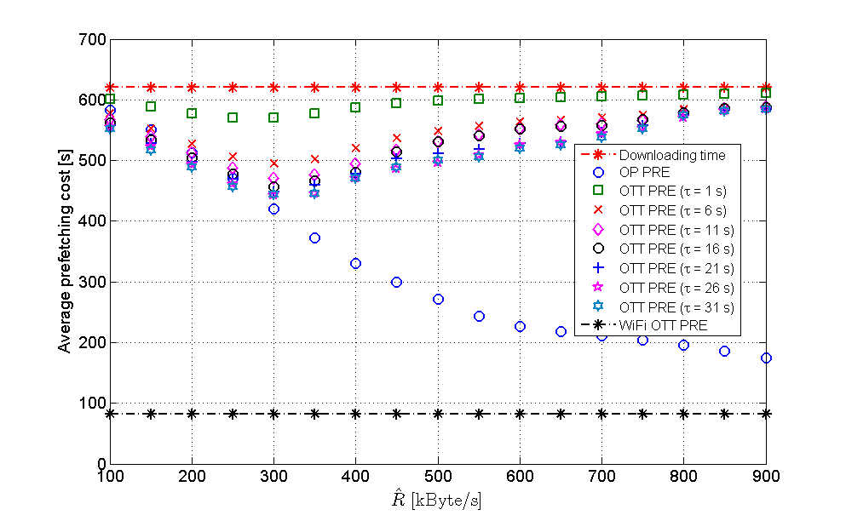
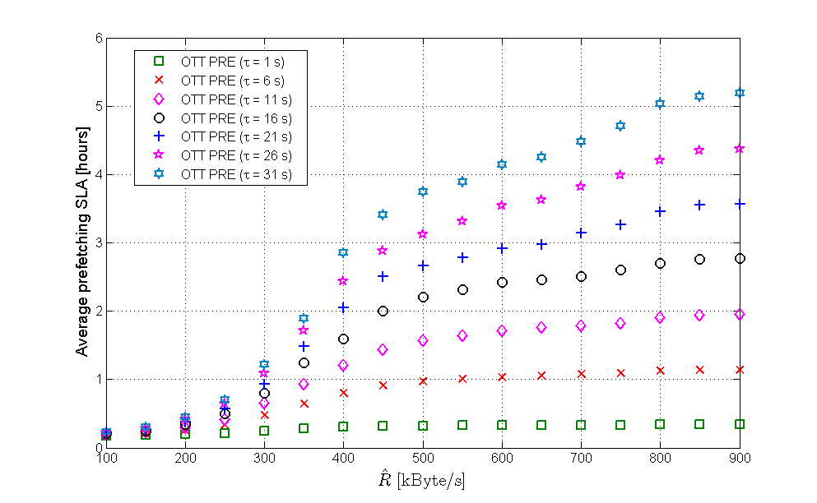
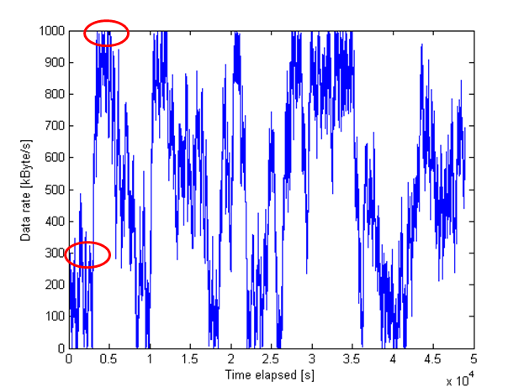
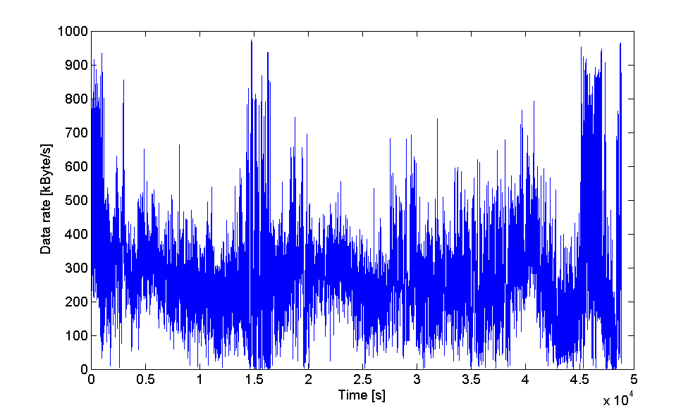
Energy cost reduction is the highest ….
Main result:
OTT PRE can achieve 20% -70% energy cost reduction
Example:
… for low average data rate and high peak-to-mean ratio
Notes:
The main result of prefetching performances is that OTT prefetching can reduce 20%-70% energy cost of video delivery compared to on demand download, depending on the pattern of user’s data rates.
An example of results are based on the mobile users data rate log shown in figure below. The upper line shows the on demand content download time, while the bottom line depicts the OTT prefetching cost if the user would have been connected to WiFi, which is only theoretical since our data rates were logged when user was connected to mobile access networks only.
The exponentially decreasing blue line depicts OP PRE, which achieves up to 72% energy cost reduction at threshold data rate of 900kByte/s, when all data rates are known in advance, compared to downloading content on demand. (Energy cost reduction is computed as a difference between the download time and prefetching cost, divided by the download time.)
Otherwise, up to 30% energy cost reduction with OTT prefetching performed at threshold data rate of 300 kByte/s and sleep time of 31 second, compared to downloading content on demand.
The OTT prefetching cost decreases until the point where most of the available data rates are equal to or lower than the threshold, which happens in this case close to the average data rate. After this point the availability of data rates that meet the threshold decreases, which increases the energy cost again since more and more content bits are prefetched during the channel probing phase. All prefetching costs converge to downloading time in case of very high threshold.
It can also be observed that the longer the sleep time is, the lower the prefetching cost, which is due to the fact that by sleeping longer increases the likelihood of moving faster away from the areas with low data rate.
The prefetching SLA increases with target prefetching data rate and the sleep time. The prefetching needs to start 1.2 hours in advance in case of maximum energy cost reduction to be available to users on time for viewing, using threshold of 300kByte/s and tau of 31 second.

Slide 16
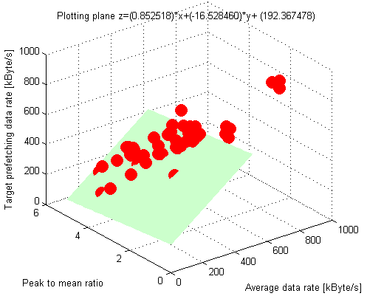
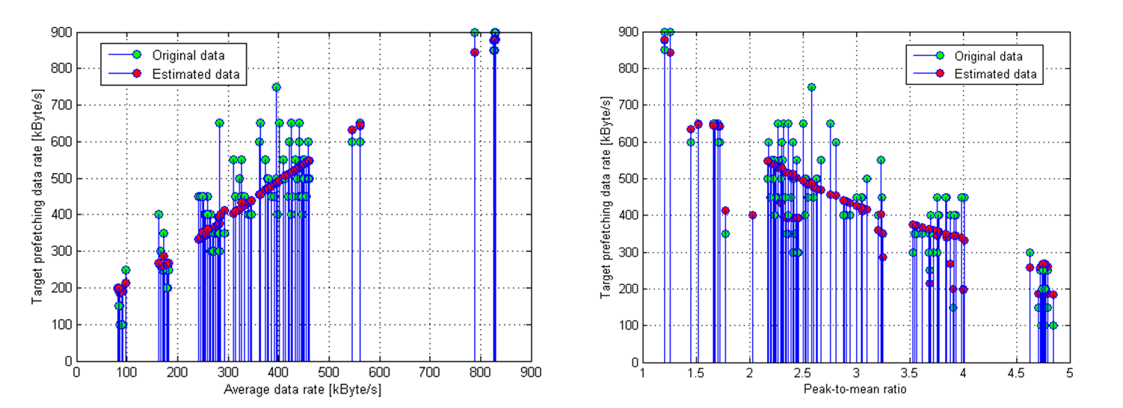
Prefetching recommendations
Optimal prefetching data rate based on statistical properties of data rates
Higher peak-to-mean and lower average data rate require lower optimal prefetching data rate!
Notes:
When deploying this prefetching technique on a mobile device, it is important to tune the prefetching parameters according the experienced network conditions in order to maximize the energy cost reduction of mobile video delivery.
We came up with a method of deriving the optimal target prefetching data rate based on statistical properties of data rates. Instead of monitoring data rates in time, with a knowledge of the average data rate and a peak to mean ratio we can estimate the optimal threshold that can maximize the energy gains.
We extracted from the prefetching results that give the maximum energy cost reduction these 3 parameter values and fitted them into the plane, obtaining this equation that has goodness of fit 0.8372 and root mean square error of 76.
We can observe from this equation that higher peak-to-mean and lower average data rate require lower optimal target prefetching data rate to maximize the energy gains.
Then we plotted the actual and estimated optimal target threshold values for different data rate channels conditions, as a function of these two parameters. We can observe that the estimated values are closest to the actual values in case of lower average data rates and high peak to mean ratios or the high average data rates and low peak to mean ratio. Here is the correlation of data rates with past values the highest, the users have routine places that they visit during the day and the data rate log is long enough to derive those locations, while in the middle of two graphs there is moderate correlation of data rates with past values, users were more deviating from their routine visiting new locations with different data rate characteristics and their logs were very short. The longer and the more precise the log is, the closer estimated to the actual optimal target prefetching data rate is expected.

Slide 17
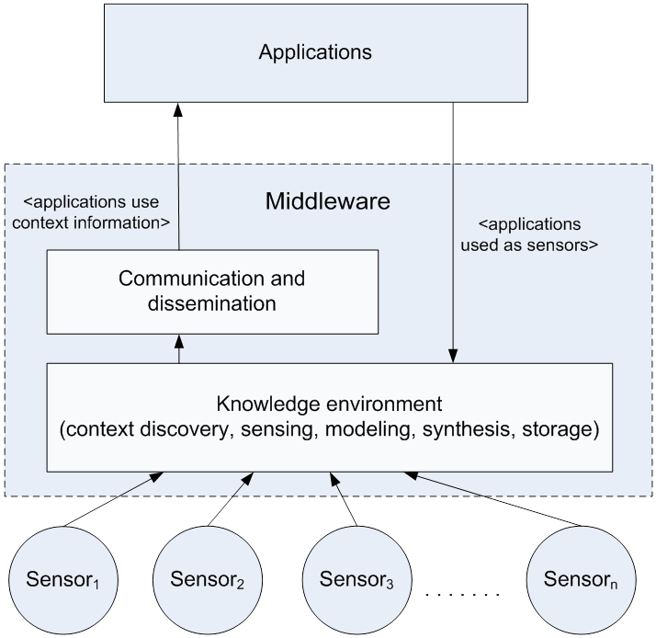
Context-awareness
Mobile video content delivery
Research question 4:
How to enable applications to discover, collect, and adapt to a new context information in timely and energy-efficient manner?
Notes:
Context-aware middleware is a mediator between sensors and applications, responsible for context discovery, collection, processing, storage, and distribution of context information to applications that needs to adapt to this information. Context information is any information that can be sensed from the environment, user’s device and that can be used to adapt the application ‘s behavior accordingly.
Applications send context queries or triggers to the middleware to obtain needed context information and they can also provide context information to the middleware, acting as context sources.
We performed different context management investigations during my licentiate thesis and since thenwhat has changed is the context-aware application (which is mobile video content delivery instead of context-aware communication) and the type of context used that is no longer centered around the user, but also around the video player, video content, network bandwidth, etc.

Slide 18
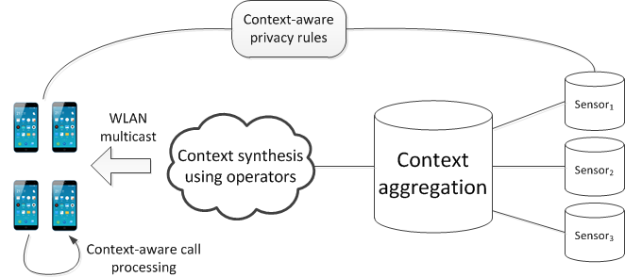
Context management activities guidelines
Mapping user privacy rules to context situations and using social relationship groups to represent context requestors, reduces number of rules that need to be evaluated upon context query arrival
It is more energy efficient to distribute context using WLAN multicast than learning it using Bluetooth, if data is sent to >3 devices at once
Context can be synthesized using operators in near real-time on a mobile device
Aggregation of context in a single notification outperforms individual context notifications for 3 or more sensors
Using context information to process incoming calls in a CPL script linearly increases the call response time, 5% per switch
These results were obtained in the scope of my licentiate thesis 2006-2009.
Notes:
This slide presents the investigations and their results that were performed in time frame of 2006 till 2009/2010. during and a bit after my licentiate thesis. Note that the results and conclusions might not be valid any longer when considering status of the mentioned technologies today, but the novelty and contributions should be judged from the given time period’s perspective.
The contributions are the following:
We investigated whether the aggregation of context updates from multiple sensors pays off (and if so, for which number of sensors) with respect to the time that is needed by application to wait for context information from each of these individual sensors. We showed that context aggregation outperforms sending of individual context updates with 3 or more sensors.
We examined if high level context can be synthesized on a mobile device in order to be used by interactive applications in sports domain running on the same device and showed on a Nokia N800 device that it is possible to perform context synthesis with an average latency of 2 seconds, while the frequency of context updates was 3 seconds. The impression of users (spectators in the race) following the synthesized context of gaps and groups of cyclists in a virtual ranking service was very positive, stating that a few seconds of delay did not affect their viewing experience.
We studied if it is more energy efficient to let each device discover context by itself when coming to a new location or to distribute once discovered context to each device in advance of arriving at a new location. We measured the battery power consumption of Bluetooth and WLAN context discovery and distribution methods on mobile devices, and showed that it is more energy efficient to distribute context using WLAN multicast than learning it using Bluetooth, if context data is sent to more than 3 devices at once.
We investigated if the proposed design of context-aware policies that maps user privacy rules to context situations and uses user social relations to represent context requesters can reduce the number of privacy rules that need to be evaluated by the privacy mechanism when the context query arrives, when compared to context-dependent policies that use context as additional condition and that needs to be evaluated upon query arrival with all other conditions. Our results show that the number of rules that need to be evaluated decreases with the number of context situations and the number of context requesters that are represented with few social relationship groups. Additionally, we showed that these social relationship groups can be inferred from user’s daily communication with others logged on a mobile phone.
As part of context-aware communication research we investigated if using context information (as external information independent of the call) to decide about how to process an incoming call affects the call response time, compared to using the attributes of the call that are extracted from the incoming call request message. We demonstrated that adding context switches to a call processing script linearly increases call response time of 5% per switch, which is due to retrieving context values from the database, before selecting and executing the appropriate script that matches this context.

Slide 19
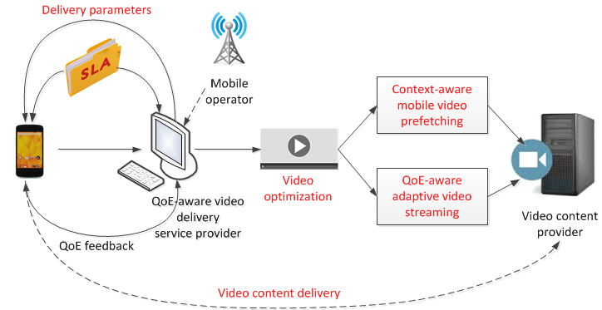
How everything fits together?
Notes:
This figure illustrates how proposed concepts fit together in an end-to-end mobile video content delivery service.
This service is envisaged to work as follows: a mobile user wants to view a video on his mobile device, having a certain requirements regarding the delivery time, perceptual video quality, and desired energy and bandwidth savings. His mobile application passes these parameters to QoE-aware video delivery service provider, in order to establish an SLA.
After an SLA has been established, the QoE-aware video delivery service provider decides about strategy that can satisfy this SLA based on network bandwidth characteristics, video quality scores, and bitrates of required content. It then suggests the video optimization and delivery actions with appropriate parameters that should be set on a mobile device when executing these actions.
Finally, after the video has been delivered to the user or the user terminates the video delivery, the mobile app on his device delivers the QoE feedback to the QoE-aware service provider, which will be explicit (provided by the user) or implicit (containing the playback events and video quality of delivered segments).
The parts depicted in red color have been addressed in the thesis, while the remaining parts need to be investigated in the future work.
There are still many open questions that need to be answered in order to implement this end-to-end solution:
How to design such QoE-aware SLA and whether the performance that has been agreed with the service provider can be guaranteed to the user? How strict the ranges of parameters need to be in SLA due to having no knowledge about the underlying network?
What is the role of mobile operators and content providers in this figure? We see their potential enrollment in: a) providing information about channel quality and signaling when there are good network conditions, b) providing resource allocation to ensure the user’s desired QoE and QoS of other running services, and c) providing video quality scores and bitrates of video segments in a multi bitrate video. In such collaboration it is not sure who would deliver the video to the end user, and where the functionality of QoE-aware service provider would be implemented?
If the same methods can be applied to multiple users at once that might be collocated, experience the same or similar network conditions, and would like to use this service. What changes would need to be made to ensure this end to end video delivery to multiple mobile users?
How could the user be involved to provide the QoE feedback after viewing the video and specify the video delivery performance requests that would be mapped to the SLA parameters?

Slide 20
Summary
Problem
Reduce mobile video traffic load and energy consumed by mobile video delivery (QoS), while maximizing the predictable user-perceived Quality of Experience (QoE)
Contributions
human- and content-aware video optimization can reduce video size up to 60% without compromising viewers’ perceived QoE
QoE-aware adaptive video streaming maintains a more stable perceptual video quality than DASH, consuming fewer bits
context-aware mobile video prefetching can reduce 20-70% energy consumption compared to on demand download

Slide 21
Thank you for the attention!
Any questions?

Slide 22
Backup slides

Slide 23
Deployment options for QoE-aware video delivery service provider
Placement | Pros | Cons | Modifications
User device | No need to share internal parameters and preferences with other entity - privacy protection | No information about video quality | Put decision making, video optimization & delivery actions in mobile device/cloud, it needs to compute statistical bandwidth properties & define SLA. Content provider needs to share video quality information with users.
Mobile operator | Knowledge about data rates and channel quality, prefetching can bring higher energy savings and shorter waiting times, direct interaction with users | No information about video quality | Move all decision making, video optimization, and delivery actions in mobile operator’s side. Content provider needs to share video quality information with the operator.
Content provider | Complete knowledge and control of video quality, keeping interaction with users | No knowledge about available bandwidth or channel quality | Move all decision making, video optimization, and delivery actions to content provider. Mobile operator or user device need to share bandwidth information with content provider.
Notes:
This slide discusses the deployment options of QoE-aware service delivery provider, where this functionality could be implemented, what are the pros and cons of each alternative, and what modifications of the proposed solution the particular alternative would require.

Slide 24
Context-aware mobile video prefetching

Slide 25
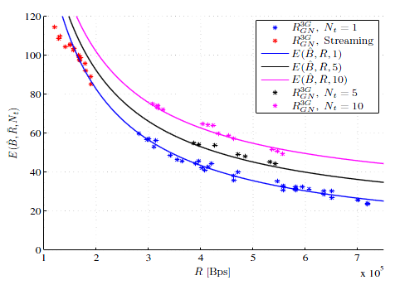

Total energy cost including number of tails
c_{a} = average cost per second of active data reception
T_{B}= total time required to download data object of size B
c_{t} = energy cost associated with duration of tail time
N_{t}(B) = number of tails during the download of object
R = average data rate during active transfer phases
Energy cost in Joules as a function of average data rate for delivering a data object of 27MB
Cost coefficients for Nexus on 3G: c_{a}=0.9656 W, c_{t}=2.5159 J
Cost coefficient for Galaxy Nexus: c_{a}=0.5739 W, c_{t}=4.16 J
Energy consumption increases with duration of data transfers and lower achievable download data rates

Slide 26
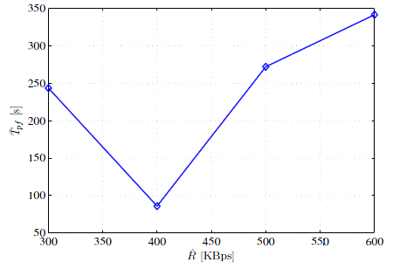
Average time to complete prefetching for 27MB
Closest to average data rate
*P. Kamaraju, P. Lungaro, Z. Segall,”A Novel Paradigm for Context-aware Content Prefetching in Mobile Networks”, WCNC 2013.

Slide 27
Experiment
A file of 13MB was periodically downloaded, with 10 min of pause after completing the download
Ran on Samsung Galaxy SII phone running Android version 2.3
    for 3 days, connected to only mobile access networks (i.e., with WiFi interface turned off)
    connecting device to WiFi would increase energy reduction even more -> worst case scenario

Slide 28
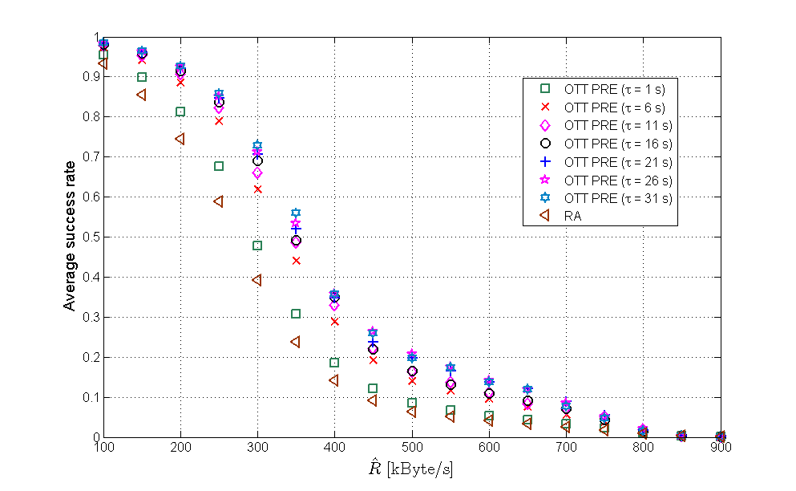
OTT prefetching compared to random access strategy
success rate - up to 32% higher than success rate of random access strategy

Slide 29
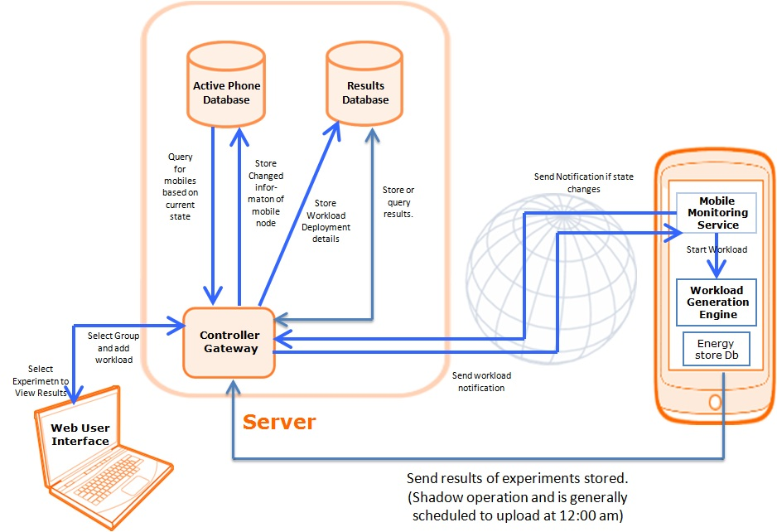
Collecting mobile users data
COSEM living laboratory (C2L) testbed*
C2L testbed - deployed periodic file download task to mobile phone and collected mobile user data
  Number of sent and received bytes from the server, terminal location, & connectivity type with absolute times
  connected to Internet via mobile access network only
Download data rates estimated by a device
Prefetching and on demand simulations ran over these data rates
10000 realizations of delivery of 160MB file†, averaged results over all runs
†average HQ YouTube video of approximately 4 minutes encoded at 5512 kbps
*P. Kamaraju, P. Lungaro, Z. Segall,”A Novel Paradigm for Context-aware Content Prefetching in Mobile Networks”, WCNC 2013.

Slide 30
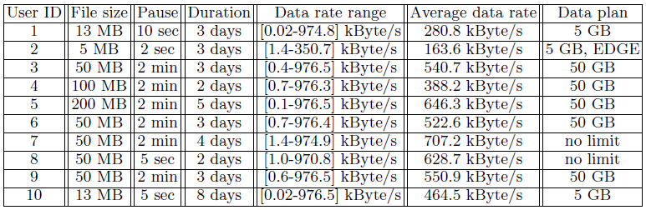
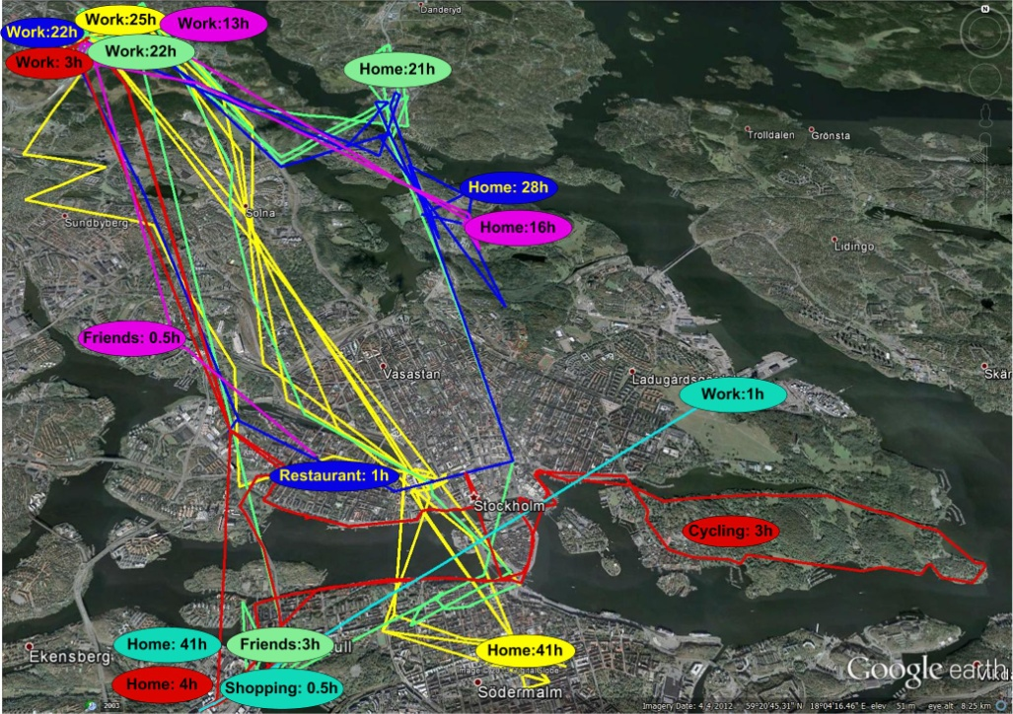
Mobile users data rate logs

Slide 31
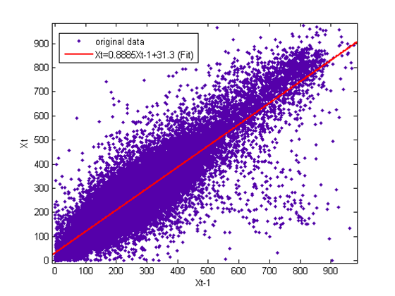
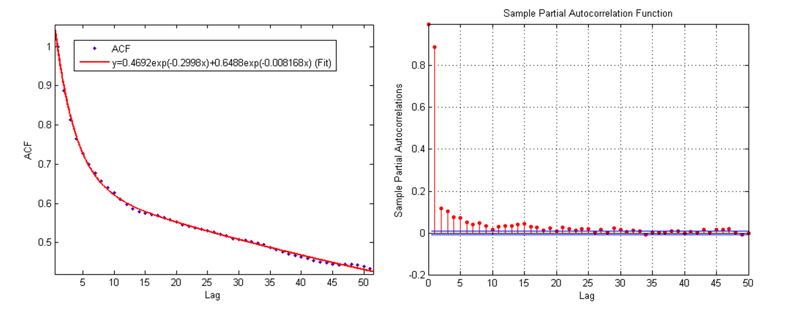
Deriving stochastic access channel model
Autoregressive process of order 1 - AR(1)
Notes:
Put slides s

Slide 32
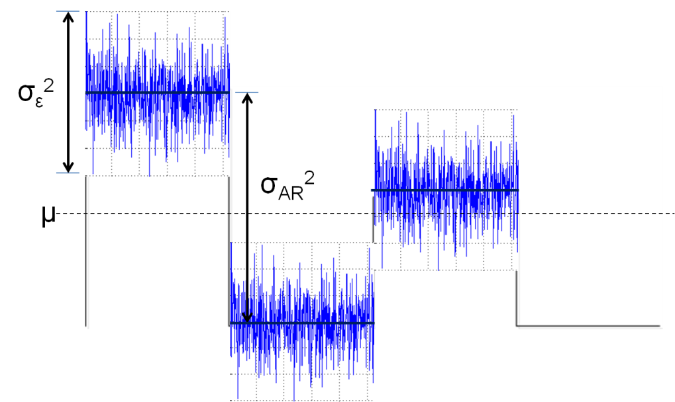
Stochastic access channel model
AR(1) process:
X_{t}=c+Ф₁X_{t-1}+ε_{t}, ε_{t}~N(0, σ_{ε}²)
X_{t} stationary -> E[X_{t}]= E[X_{t-1}]=µ
Can be described with 3 parameters:
process mean µ
process variance σ_{AR}²
noise variance σ_{ε}²

Slide 33

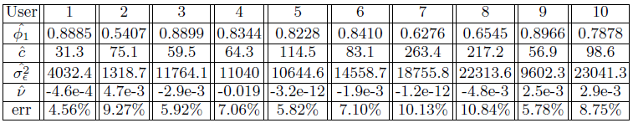
Fitting data rates to AR(1)
Using Burg method, by minimizing sum of the squares of the error between original and estimated values
Innovations are estimated using:
and fitted to Gaussian probability distribution to obtain noise mean and noise variance
Innovations mean values are close to zero – can be approximated by white noise!

Slide 34

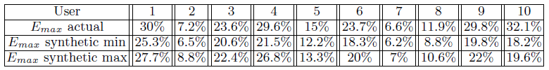
Prefetching results
100 realizations of synthetic data rates generated using AR(1) with the fitted parameters
10000 prefetching iterations and on demand download with different starting indices performed over synthetic data rates
E_{max} computed in each iteration
E_{max} obtained from prefetching over actual and fitted users data rates:

Slide 35
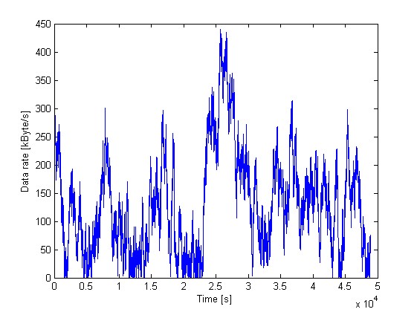
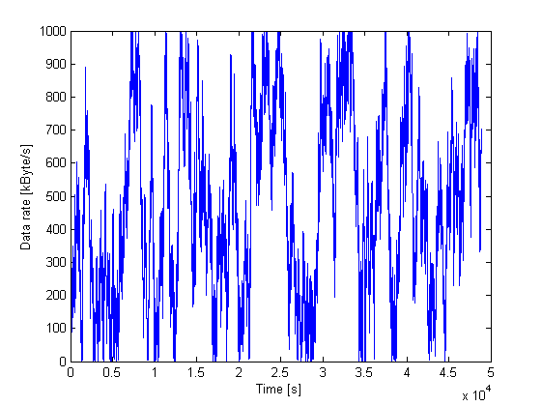
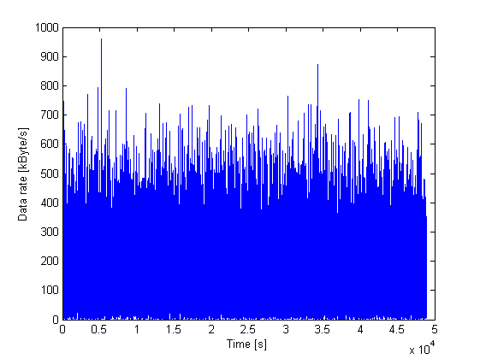
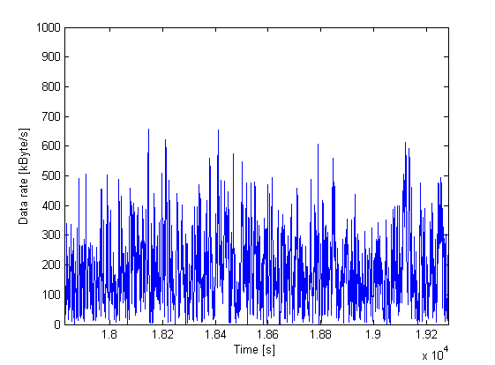
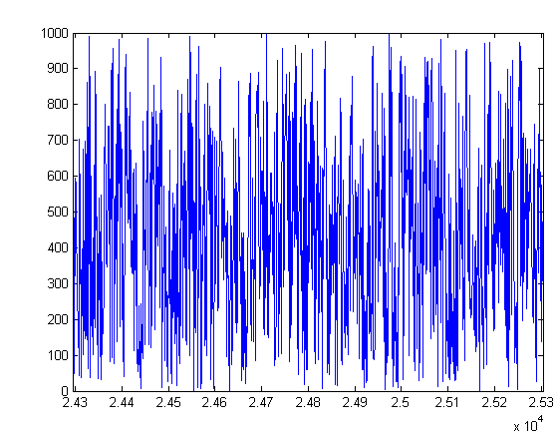
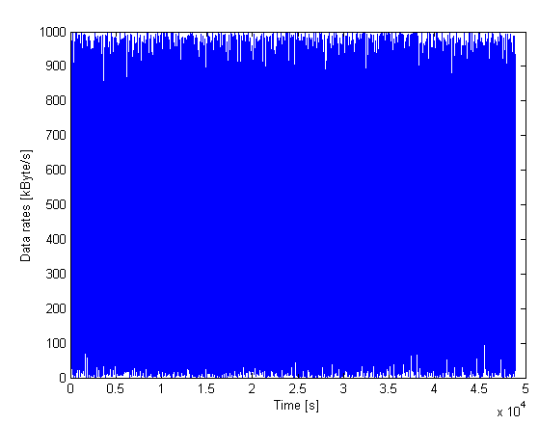
Other types of channels
High correlation, low process variance
High correlation, high process variance
k=σ_{ε}²/σ_{AR}²= 0.0004
σ_{AR}²=40000
σ_{ε}²=16
µ =173kByte/s
Peak-to-mean=3.25
Energy saving ≈ 66%
(OTT PRE)
R^=350kByte/s
R ^_{est}=286kByte/s
PRE SLA = 1h15min
k=σ_{ε}²/σ_{AR}²= 0.0004
σ_{AR}²=640000
σ_{ε}²=256
µ =422kByte/s
Peak-to-mean=2.41
Energy saving ≈ 58%
(OTT PRE)
R^=600kByte/s
R ^_{est}=512kByte/s
PRE SLA = 47 min
Medium correlation, low process variance
Medium correlation, high process variance
k=σ_{ε}²/σ_{AR}²= 0.4
σ_{AR}²=10000
σ_{ε}²=4000
µ =91kByte/s
Peak-to-mean=4.77
Energy saving ≈ 18%
(OTT PRE)
R^=100kByte/s
R ^_{est}=190kByte/s
PRE SLA = 4h
k=σ_{ε}²/σ_{AR}²= 0.4
σ_{AR}²=360000
σ_{ε}²=144000
µ =397kByte/s
Peak-to-mean=2.52
Energy saving ≈ 14%
(OTT PRE)
R^=500kByte/s
R ^_{est}=489kByte/s
PRE SLA = 39 min
Notes:
What happens to the mean and peak-to-mean ratio? And where should the target prefetching data rate be set? How much below the average data rate?

Slide 36
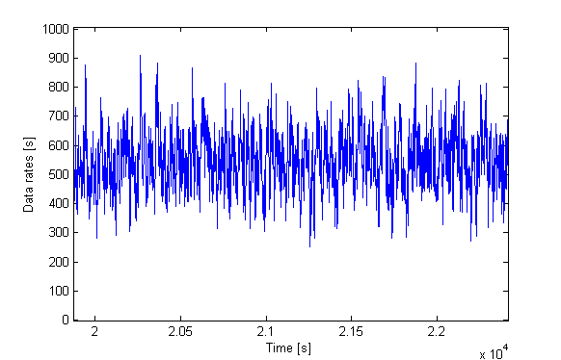
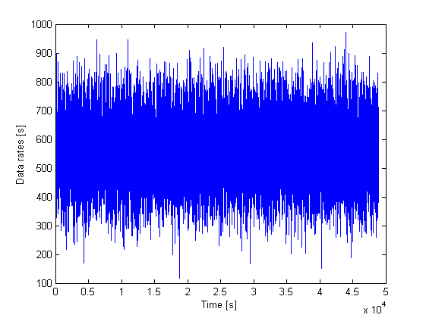
If we increase process mean
k=σ_{ε}²/σ_{AR}²= 0.4
σ_{AR}²=10000
σ_{ε}²=4000
µ =90kByte/s
Peak-to-mean=4.77
Energy saving ≈ 20%
(OTT PRE)
R^=100kByte/s
R ^_{est}=190kByte/s
PRE SLA = 3.7h
k=σ_{ε}²/σ_{AR}²= 0.4
σ_{AR}²=10000
σ_{ε}²=4000
µ = 562 kByte/s
Peak-to-mean=1.72
Energy saving ≈ 8%
(OTT PRE)
R^=600kByte/s
R ^_{est}=643kByte/s
PRE SLA = 36 min

Slide 37
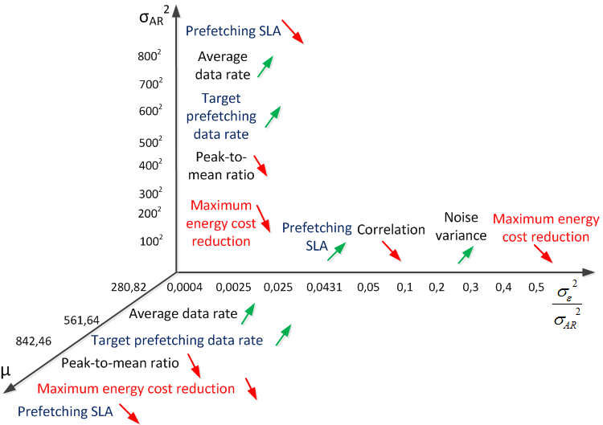
Prefetching performances depending on channel model parameters

Slide 38
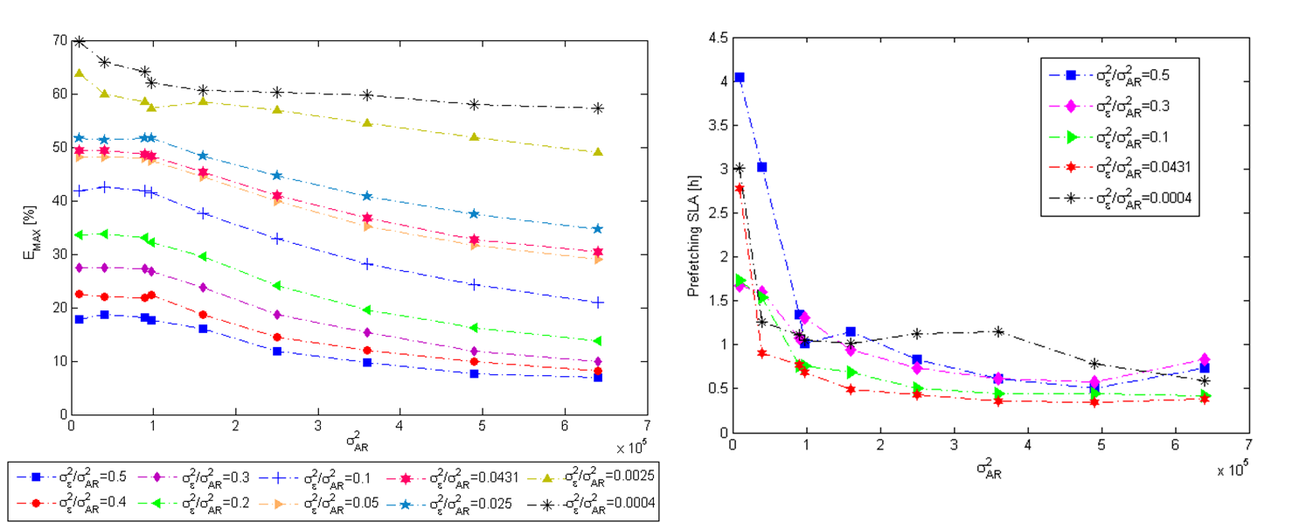
Prefetching results – cntd.
To simulate different access channels and user behavior, we scanned the entire AR(1) parameter space (µ, σ_{AR}², σ_{ε}²)
Impact of process variance on E_{max} and prefetching SLA:

Slide 39

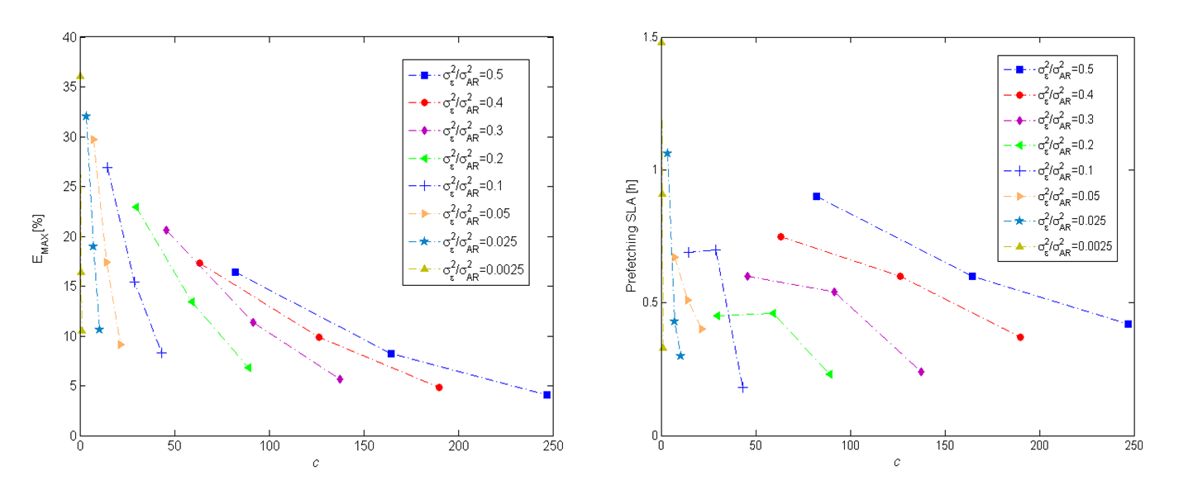
Prefetching results – cntd.
Impact of constant c on the range and average data rate [kByte/s], using φ1=0.8885:
σ_{AR}² = 100²

Slide 40

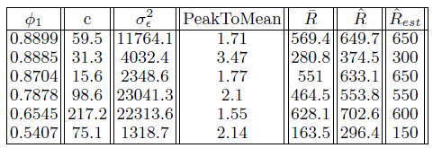
Prefetching prediction results
predicts optimal target prefetching data rate ( ) for 6 channel states extracted from mobile users traces
predictions are close to actual values for data rates with strong correlation (higher φ₁)
moderate correlation observed in shorter data rate logs and deviations of mobile user behavior from daily routine

Slide 41
Video optimization

Slide 42
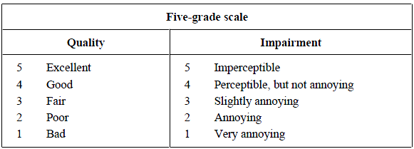
How to measure perceptual video quality/QoE?
captured via Mean Opinion Scores (MOS)
- video sequences are shown to the users, whose opinion is recorded and averaged into MOS
Represents quality degradation of impaired video when compared to reference video
Subjective video quality tests – most accurate, but very expensive
Objective video quality metrics – mathematical models approximating results of subjective tests
  their performance is evaluated by correlating results with MOS grades

Slide 43
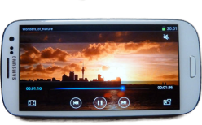
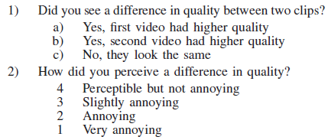
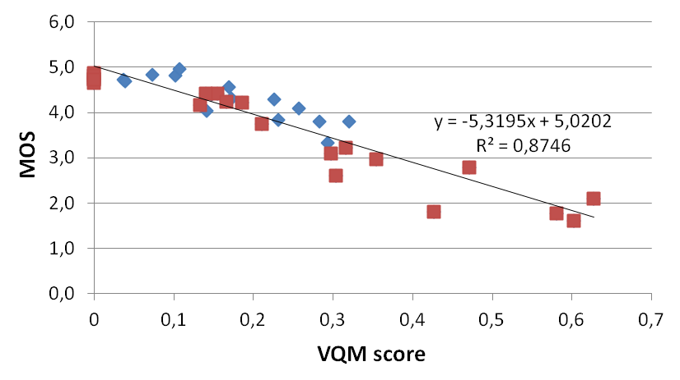
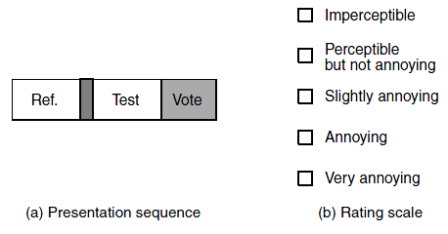
Subjective video quality tests
6 clips, each with 7 qualities:
  720p
  480p
  360p
  240p
  VQM threshold = 0.11
  VQM threshold = 0.21
  VQM threshold = 0.31
Double Stimulus Impairment Scale (DSIS) method
Test: 32 people, 20-33 years old, 87.5% men,
50% had contact lenses or glasses

Slide 44
Video optimization

Slide 45

Video optimization algorithm
The quality of optimized segments will always be equal to or higher than the desired video quality, depending on available VQM scores

Slide 46

Converging optimization algorithm
By iterating video optimization, tuning VQM threshold to previously achieved VQM score, desired quality (or closest) can be achieved!
Amazing Spiderman
10 sec long video

Slide 47



MOS vs. video file sizes
Increasingly more bits needs to be spent to notice a difference in video quality!
Large bandwidth gap between existing resolutions (especially largest ones)!
MOS given by users for fixed and optimized video clips follow logarithmic function of their file sizes. It is possible to predict bandwidth savings of a video optimized for particular MOS!

Slide 48
Estimating size of optimized long videos (movies)
Linear interpolation method
VQM score vs. file size before and after removing short peaks
Estimating size of 15 seconds optimized movie segments
Prediction error up to 8.6%

Slide 49

Performance measures for computing bandwidth savings
For selection of reference resolution:
VQM threshold >= 95th percentile
Reference movie resolution – minimum resolution of all movie segments, whose 5% worst quality is higher than perceptual quality of optimized movie
Bytes saved - difference between the size of movie in reference resolution and the optimized movie size
Bandwidth savings - ratio of bytes saved by optimizing movie and movie size in reference resolution

Slide 50


Video optimization results
Results:
Macro optimization:
Up to 50% savings MOS = 4.5
Up to 60% savings MOS = 4
Micro optimization:
Additional 10% savings
3 GB for MOS = 4.5
1.8 GB for MOS = 4

Slide 51



Tailoring video optimization to individual user perception
Based on scores of all users
ExtraMOS = fixedMOS – SOS
Based on individual user’s votes
ExtraBytes= userVideoSize – populationVideoSize
Total extra bytes = SUM(ExtraBytes)
= 2.97 GB with extreme user
= -140 MB without extreme user
Fixed MOS = 4

Slide 52

Predicted average data rate distances
Using the average data rate of previous 4 minutes, we predicted average data rate of the next 4 minutes of data rate trace
computing distances between the predicted and actual average data rate
throughout the entire trace
90th percentile of predicted average data rates lie in the range of average
data rate ±100 kBytes/s (between 5th and 95th percentile)

Slide 53

Applications of video optimization
QoE-aware video storage – downloads and stores optimized videos according to individual user perception to a mobile device
QoE-aware video delivery – streams optimized video on top of DASH
Optimal perceptual video quality for optimizing video
VQM score of 4 min video = 5% worst video quality of 15 sec segments
4 min long IronMan video
Trace shaped bandwidth (mean 464kB/s and st.dev. 157.51kB/s)

Slide 54


Economic analysis: Netflix video content delivery over Akamai’s CDN
Average Netflix user (age 13-54) watches 8 hours content a week over 2 Mbps data rate
23 million of subscribers *2Mbps*8 hours/week ≈ 153,54 petabytes data traffic per week
60% of savings per movie ≈ 107 petabytes per week reduced network bandwidth
1.5 cents per GB for video delivery paid to Akamai’s CDN
≈ 1.7 million US dollars cost reduction per week!
vs.
Content Delivery Network
Without compromising QoE for the viewer!

Slide 55
QoE-aware adaptive video streaming

Slide 56


QoE-aware adaptive video streaming
Optimized video’s bitrates
Estimated data rate
Remaining bandwidth is used to prefetch future optimized video segments
Better QoE performance than DASH for 20%-60% of worst video qualities, while achieving 2%-38% bandwidth savings

Slide 57

QoE-aware adaptive video streaming results

Slide 58

QoE-aware mobile video delivery system architecture

Slide 59


Performance comparison of QoE-aware adaptive video streaming and DASH

Slide 60



Different behaviors of MOS distributions of QoE-aware and DASH video streaming
“Avengers” channel 2
“Skyfall” channel 3
“IronMan” channel 1

Slide 61



Resolution switch comparison of QoE-aware adaptive video streaming vs. DASH

Slide 62



MOS of video segments streamed using DASH and QoE-aware streaming
“Avengers” channel 2
“IronMan” channel 2
“Skyfall” channel 2
Optimal target video quality = the highest target video quality of QoE-aware streaming for the given video and access channel, whose σ is lower than 10%

Slide 63

Prediction of optimal target video quality
Video needs to be optimized for (optimal) target video quality before the streaming starts
QoE resulting from this prediction is at most 0.15 MOS points lower than QoE resulting from the maximum achievable target MOS!

Slide 64

Prediction error of optimal perceptual video quality across percentiles of MOS distribution
and impact on QoE

